Slide 1
PLAN MANAGEMENT ADVISORY GROUP MEETING
September 6, 2018

Slide 2
WELCOME AND AGENDA REVIEW
ROB SPECTOR, CHAIR
PLAN MANAGEMENT ADVISORY GROUP

Slide 3
AGENDA
AGENDA
Plan Management and Delivery System Reform Advisory Group
Meeting and Webinar
Thursday, September 6, 2018, 10:00 a.m. to 12:00 p.m.
September Agenda Items Suggested Time
Welcome and Agenda Review 10:00 - 10:05 (5 min.)
Plan Selection Decision Support Tools: Future Capabilities Discussion 10:05 - 10:40 (35 min.)
Benefit Design 2020 10:40 – 11:05 (25 min.)
Subcommittee Update 11:05 – 11:45 (40 min.)
  AB 1810 Affordability Reporting Requirements
  Survey Results
Open Forum 11:45 – 12:00 (15 min.)
Notes:
Quality Rating System for 2019 Open Enrollment will now be discusssed in October.
October meeting has been moved from the 4th to to the 11th, due to Board meeting shift.

Slide 4
Plan Selection decision support tools:
FUTURE CAPABILITIES discussion
MARGARETA BRANDT, SENIOR QUALITY SPECIALIST
PLAN MANAGEMENT DIVISION

Slide 5
PLAN SELECTION DECISION SUPPORT TOOLS:
FUTURE CAPABILITIES
Prescription Drug Search: a tool that would enable a consumer to search by prescription drug and see whether the drug is covered by a health plan.
Primary Care Provider (PCP) Selection: a tool that would enable a consumer to select a PCP after they have selected a health plan and their selection would be transmitted to the health plan along with their enrollment information.
The goal of implementing either of these tools is to enable consumers to make an informed decision when selecting a health plan through Covered California and improve the enrollment experience.
Notes:
Framing: getting feedback from issuers and consumer advocates on their interest in implementing these tools. Based on feedback from the group, Covered CA will determine next steps.
What additional information you would like to know? What questions should Covered CA ask other Exchanges that have similar tools? What questions should we ask GI?
Functionality and Consumer Experience
Example from Mnsure / Mock up from GetInsured
Data Elements to display
Considerations

Slide 6
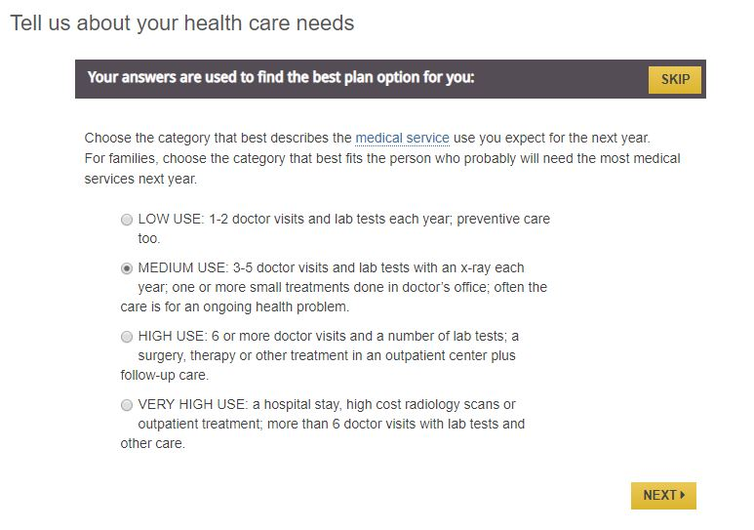
CURRENT CONSUMER PREFERENCES PAGES:
MEDICAL SERVICE USAGE

Slide 7
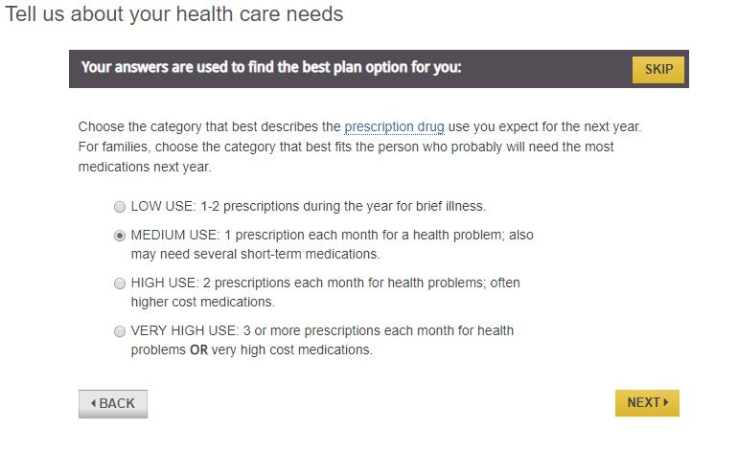
CURRENT CONSUMER PREFERENCES PAGES:
PRESCRIPTION DRUG USAGE

Slide 8
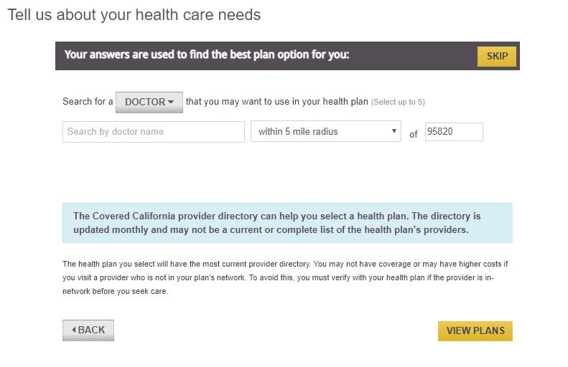
CURRENT CONSUMER PREFERENCES PAGES:
PROVIDER SEARCH TOOL

Slide 9
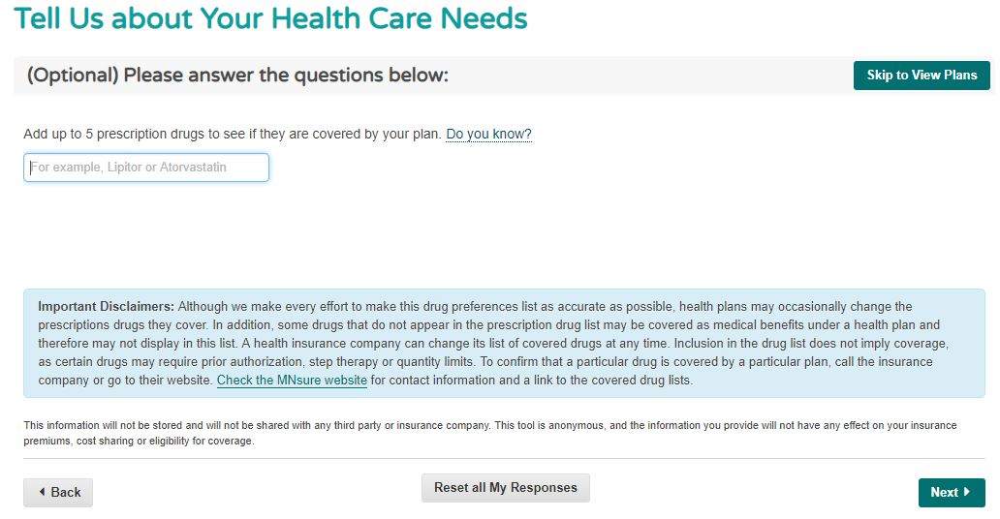
PRESCRIPTION DRUG SEARCH: MNsure Example
Language in questions and disclaimers can be edited by Covered California.
Formulary search screenshots from MNsure shopping tool: https://www.mnsure.org/
Notes:
Question located within the “Consumer Preferences” section before the plan selection pages.

Slide 10
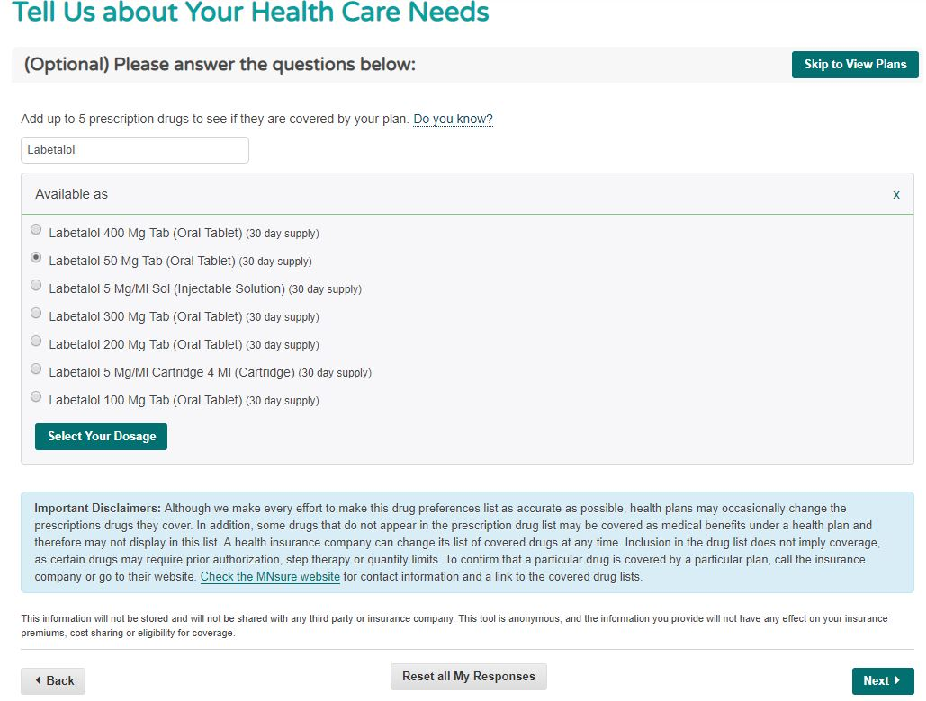
PRESCRIPTION DRUG SEARCH:
MNsure Example
Once a consumer searches by the prescription drug name, they are prompted to select the dosage for the drug.
In the MNsure tool, a consumer must select a dosage.
Formulary search screenshots from MNsure shopping tool: https://www.mnsure.org/

Slide 11
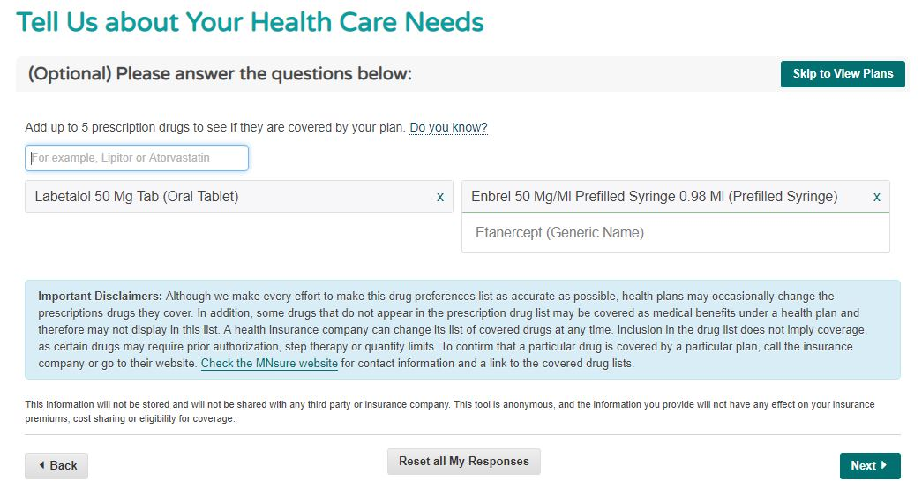
PRESCRIPTION DRUG SEARCH: MNsure Example
Formulary search screenshots from MNsure shopping tool: https://www.mnsure.org/

Slide 12
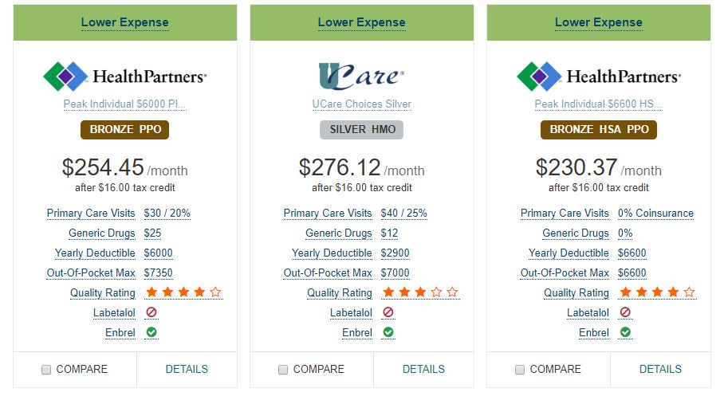
PRESCRIPTION DRUG SEARCH: MNsure Example
After a consumer selects the drugs they would like to search by and then moves forward to view plans, the plan tile indicates whether the drug is “Covered” or “Not Covered”.
Hover text also notes whether Prior Authorization is required and whether Step Therapy is required for a drug. The hover text is drug specific.
Formulary search screenshots from MNsure shopping tool: https://www.mnsure.org/

Slide 13
PRESCRIPTION DRUG SEARCH: DATA ELEMENTS
Information currently provided to Covered California by issuers:
  RXCUI – a unique identifier for prescription drugs
    This unique identifier can be mapped to a name, dosage and description of the drug using a crosswalk.
  Tier Level
    Tier 1 – Most Generic Drugs
    Tier 2 – Preferred Brand Drugs
    Tier 3 – Non-Preferred Brand Drugs
    Tier 4 – Specialty Drugs
  Whether prior authorization is required
  Whether step therapy is required
Other data elements needed?
  Dosage information
Notes:
RXCUI - RxNorm concept unique identifier
A standardized identifier for prescription drugs developed by NIH US National Library of Medicine

Slide 14
PRESCRIPTION DRUG SEARCH: CONSIDERATIONS
Determine an agreed upon data source
  Issuer formularies
  RXCUI unique identifier for prescription drugs and crosswalk
Frequency of updating data to support the search
  Currently, Covered California only receives prescription drug information once per year during the QHP Certification Application process
Ease of search
  Do consumers know the prescription drug generic or brand names?
Display of information
  Are the “Covered” and “Not Covered” symbols clear?
  Is different hover text needed?
Potential unintended consequences or perverse outcomes

Slide 15
PRIMARY CARE PROVIDER (PCP) SELECTION
This functionality would enable a consumer to select a PCP after the consumer has selected a health plan
  Each member would be able to select a unique PCP (one PCP per family member)
  The consumer’s PCP selection information would then be passed to the issuer via an 834 transaction
This functionality would address the issue of auto-assignment to a PCP by an issuer
  However, using the PCP Selection tool would be optional for consumers
PCP Selection would be available to a consumer making an initial plan selection or actively changing plans during renewal
  Based on the current design mock ups, a consumer would only be able to select a PCP during enrollment and would not be able to return to their portal and make a PCP Selection later
Would require standardization and validation of additional data elements in the provider data submissions received from issuers
Would require system changes for issuers

Slide 16
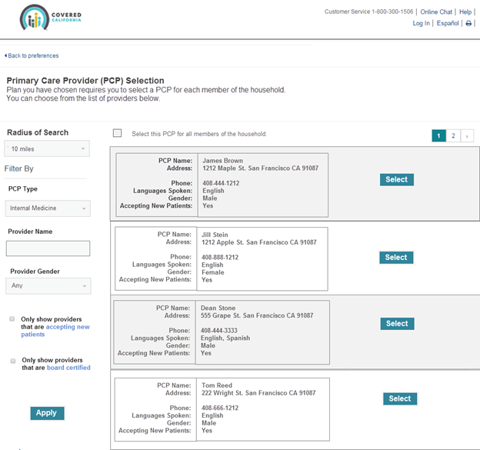
PCP SELECTION: DRAFT MOCK UP
Covered California can adjust the filters, or choose not to display filters.
Language can be edited by Covered California.

Slide 17
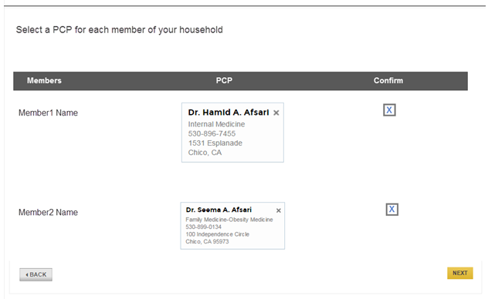
PCP SELECTION: DRAFT MOCK UP
Each member would be able to select a unique PCP.
One PCP could be selected for each family member.
Not all family members would be required to select a PCP.

Slide 18
PCP SELECTION: DATA ELEMENTS
Covered California currently receives monthly provider network data files from issuers, but not all data fields are standardized across issuers.
Required elements from issuers:
Identification of PCPs per issuer product (PPO, EPO, HMO)
Possible data elements to display for each PCP:
Medical group affiliation
Independent Physician Association (IPA) affiliation
PCP Specialty
Gender
Language
Accepting New Patients or Panel Status

Slide 19
PCP SELECTION: CONSIDERATIONS
Search may need to differ based on product (PPO, EPO, HMO)
  Issuers have noted the need to be able to search by medical group/IPA first and then select a PCP for HMO products
The 1 to many relationship of PCPs to medical groups/IPAs
  How many PCPs does this impact?
  Does a consumer need to select a medical group/IPA first and then search to select a PCP?
Need to standardize medical group/IPA names across all issuers
Will need to standardize other data fields
  Language
  Gender
  Accepting new patients
Determine the necessary information to transmit to issuers on an 834
CalHEERS and GetInsured would need to build a PCP Selection tool for Covered California
Opportunity to implement along with Covered California’s transition to using the statewide provider directory (IHA Provider Directory Utility)

Slide 20
BENEFIT DESIGN 2020
ALLIE MANGIARACINO, SENIOR QUALITY ANALYST
PLAN MANAGEMENT DIVISION

Slide 21
BENEFIT DESIGN 2020: WORKGROUP PLANNING
Discussion Topics (tentative)
2020 Standard Benefit Plan Designs
  Copay-only plan design
  MHPAEA impacts to standard benefits
  Funded Savings Account Plans
Beyond 2020
  Understanding cost-sharing experience by enrollee disease state
  VBID-X: National workgroup proposal on designing a Value-Based Insurance Design (VBID) for the individual market
  Proposed Scheduling
  4 – 6 meetings
  Every other Wednesday, 10 a.m. – 12 noon or 1 – 3 p.m.
  Discussion topics for 2021 may transition to the Plan Management Advisory Group meetings starting in January

Slide 22
SUBCOMMITTEE UPDATE
ROB SPECTOR
CHAIR, PLAN MANAGEMENT ADVISORY GROUP

Slide 23
AB 1810 Affordability Reporting Requirements
KATIE RAVEL, DIRECTOR
POLICY, EVALUATION & RESEARCH

Slide 24
AB 1810 AFFORDABILITY OPTIONS REPORT
AB 1810 Trailer Bill requires Covered California to develop an Affordability Options Report to the Legislature, Governor, and the new Council on Health Care Delivery Systems
Covered California must:
  Consult with stakeholders, Department of Health Care Services, and Legislature and develop options for providing financial assistance to help low- and middle-income Californians access health care coverage.
  Include options to assist low-income individuals paying a significant percentage of income on premiums, even with federal financial assistance, and individuals with annual income of up to 600 percent of federal poverty level.
  Consider maximizing all available federal funding and determine whether federal financial participation for Medi-Cal would otherwise be jeopardized.
Report due by February 1, 2019

Slide 25
AFFORDABILITY WORK GROUP
Request volunteers to participate as members of the Affordability workgroup
Workgroup members will be expected to participate in two to three workgroup meetings between October and January to provide input on affordability options
If you are interested in participating on the workgroup, please email Mandy Horrell (mandy.horrell@covered.ca.gov)

Slide 26
PLAN MANAGEMENT ADVISORY SURVEY ON TOPIC PRIORITIES AND FORUMS
LINDSAY PETERSEN, SENIOR QUALITY SPECIALIST
PLAN MANAGEMENT DIVISION

Slide 27
SURVEY RESULTS: RESPONDER BREAKDOWN
Participant Type | Number of Responders
Plan Management Advisory or Board Member | 11
Non-member regular attendee | 10
Total | 21
Stakeholder Category | Number of Responders
Advocate | 7
Health Plan | 9
Provider Organization | 4
Other | 1
Total | 21

Slide 28
SURVEY RESULTS
Survey results indicated overall group desire to:
Continue subcommittees on
  Benefit Design
  Dental Technical
Address the following either as an ad hoc or folded into a different subcommittee:
  Access and Cost of Care
  Prescription Drugs
  CCSB
The following topics had split opinions:
Consumer Experience
Health Equity
Quality of Care
New topics suggested:
Renewal notice template (completion ~May)
Medi-Cal/Covered California transition continuity

Slide 29
SURVEY RESULTS: NEXT STEPS
Separate benefit design and dental technical work groups will continue.
Updates to Plan Management Advisory on any standing, or ad hoc subcommittee activities will continue.
Respondents indicated desire to be present if any of these topics were addressed, and expressed importance of prioritizing based on specific issue need, and staggering throughout the year due to limited bandwidth.
  Based on feedback, Covered California will determine forums for the other topics and will update the group.
Staff will use more channels to communicate about past and future Plan Management Advisory and subcommittee meetings.
  All Plan Management Advisory meeting agendas are posted publicly on the Plan Management stakeholder page, in addition to a master calendar with all meetings dates.
  Subcommittee announcements take place at public meetings, but additional subcommittee announcements and contact information can be added to stakeholder page.
  Thank you for completing the survey!

Slide 30
OPEN FORUM AND NEXT STEPS
ROB SPECTOR, CHAIR
PLAN MANAGEMENT ADVISORY GROUP

Slide 31
OPEN FORUM ITEMS
Membership solicitation for the Marketing, Outreach, and Enrollment Assistance (MOEA) Advisory Group
  Covered California seeks members who bring knowledge and expertise in the areas of marketing, outreach, and enrollment assistance, and who also have experience serving or working with California’s richly diverse populations to join the Marketing, Outreach, and Enrollment Assistance (MOEA) Advisory Group
  Anyone interested in serving is invited to submit an application and letter of interest to MOEAGroup@covered.ca.gov by September 14, 2018. The membership application as well as a draft charter describing the group in more detail can be found at http://hbex.coveredca.com/stakeholders/Marketing-Outreach-Enrollment/
  Questions can be addressed to Ashley Nichols at MOEAGroup@covered.ca.gov

