Slide 1

1

Slide 2

Help your constituents gain the most from the Affordable Care Act
Quick refresher course on Covered California: your destination for affordable, quality health care, including Medi-Cal
Help your constituents with three big questions:
  What’s in it for me?
  What do I need to consider in making a decision?
  How do I enroll?
Get ready for enrollment on October 1, 2013
2
Notes:
Rates for these health plans will vary by region, ZIP code, metal level, and age. The chart shows the regions as broken up by price across California. In each region, there are at least three different health insurance companies offering all 5 levels of coverage – Platinum, Gold, Silver, Bronze and Catastrophic – with many regions with more.

Slide 3

Eligible if:
A U.S. Citizen, U.S. National, or a non-citizen who is Lawfully Present in the U.S.;
  For Medi-Cal, immigration status
  only effects the scope of service
  (e.g. “emergency room only” or “pregnancy only”)
A California Resident; AND
Not incarcerated, other than incarceration pending the disposition (judgment) of charges.
  Except Medi-Cal Inmate Eligibility Program
3
Notes:
Rates for these health plans will vary by region, ZIP code, metal level, and age. The chart shows the regions as broken up by price across California. In each region, there are at least three different health insurance companies offering all 5 levels of coverage – Platinum, Gold, Silver, Bronze and Catastrophic – with many regions with more.

Slide 4
Eligible for Premium Assistance and Cost-Sharing Subsidies in Covered California if:
Purchase coverage through Covered California;
Under certain income requirements; AND
Not eligible for Minimum Essential Coverage (i.e. Medi-Cal, Medicare, or coverage through an employer that is affordable).
4
Notes:
Rates for these health plans will vary by region, ZIP code, metal level, and age. The chart shows the regions as broken up by price across California. In each region, there are at least three different health insurance companies offering all 5 levels of coverage – Platinum, Gold, Silver, Bronze and Catastrophic – with many regions with more.

Slide 5
Quick summary of income ranges
Cost Sharing + Premium Assistance
Premium Assistance Only
Medi-Cal
Medi-Cal for Children
Number | Up to or at 138% | Over 138% | 150% | 200% | 250% | 400%
1 | $15,856 | $15,857 | $17,235 | $22,980 | $28,725 | $45,960
2 | $21,403 | $21,404 | $23,265 | $31,020 | $38,775 | $62,040
3 | $26,951 | $26,952 | $29,295 | $39,060 | $48,825 | $78,120
4 | $32,499 | $32,500 | $35,325 | $47,100 | $58,875 | $94,200
5
Notes:
Rates for these health plans will vary by region, ZIP code, metal level, and age. The chart shows the regions as broken up by price across California. In each region, there are at least three different health insurance companies offering all 5 levels of coverage – Platinum, Gold, Silver, Bronze and Catastrophic – with many regions with more.

Slide 6
What are you eligible for?
≤ 138% FPL
Low or No Cost
Medi-Cal
Adults:
Covered California
Premium Assistance + Enhanced Benefits*
*Must enroll in a Silver-level plan to receive enhanced benefits
Children: Low or No Cost
Medi-Cal
Over 138% FPL to 250% FPL
Over 138% FPL to 400% FPL
Covered California
Over 250% FPL to 400% FPL
Covered California
Premium Assistance with Standard Benefits
Over 400% FPL
Option for Covered California with Standard Benefits and Prices
6
Notes:
Rates for these health plans will vary by region, ZIP code, metal level, and age. The chart shows the regions as broken up by price across California. In each region, there are at least three different health insurance companies offering all 5 levels of coverage – Platinum, Gold, Silver, Bronze and Catastrophic – with many regions with more.

Slide 7
Modified Adjusted Gross Income (MAGI) is a driver of eligibility
Take your:
Adjusted Gross Income
+
Non-taxable Social Security beneﬁts
(Line 20a minus 20b on a Form 1040)
Tax-exempt interest (Line on 8b on a Form 1040)
Foreign earned income & housing expenses for Americans living abroad (calculated on a Form 2555)
_
Scholarships, awards, or fellowship grants used for education purposes (not living expenses)
Certain American Indian and Alaska Native income derived from distributions, payments, ownership interests, real property usage rights, and student financial assistance
An amount received as a lump sum is counted as income only in the month received
For Medi-Cal Eligibility,
Exclude From Income:
7
Notes:
Rates for these health plans will vary by region, ZIP code, metal level, and age. The chart shows the regions as broken up by price across California. In each region, there are at least three different health insurance companies offering all 5 levels of coverage – Platinum, Gold, Silver, Bronze and Catastrophic – with many regions with more.

Slide 8
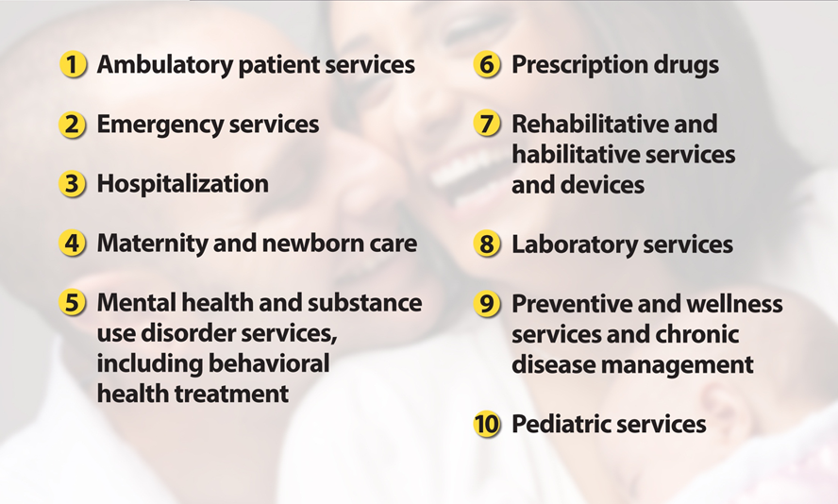
The Essential Health Benefits
8
Notes:
Rates for these health plans will vary by region, ZIP code, metal level, and age. The chart shows the regions as broken up by price across California. In each region, there are at least three different health insurance companies offering all 5 levels of coverage – Platinum, Gold, Silver, Bronze and Catastrophic – with many regions with more.

Slide 9
Medi-Cal
9

Slide 10

We’ve Streamlined the Application Process
Applying at Covered California, lets you know if your income makes you eligible for affordable coverage
^{Enrolling:}
Service Center: We’ll help you find your local Medi-Cal county office for quick help.
Certified Enrollment Counselor or Certified Insurance Agent: Our counselors and agents will
let applicants know their status.
County Social Services Office: Where applicants can get their full Medi-Cal eligibility determination using MAGI and Non-MAGI income eligibility rules.
10

Slide 11
We’ve Simplified Eligibility and How We Verify Information
We allow self-attestation & “reasonably compatible” reviews
We have access to a federal electronic verification hub
We’ll use the MAGI income standard
We’ve made verifying state residency easier
11

Slide 12
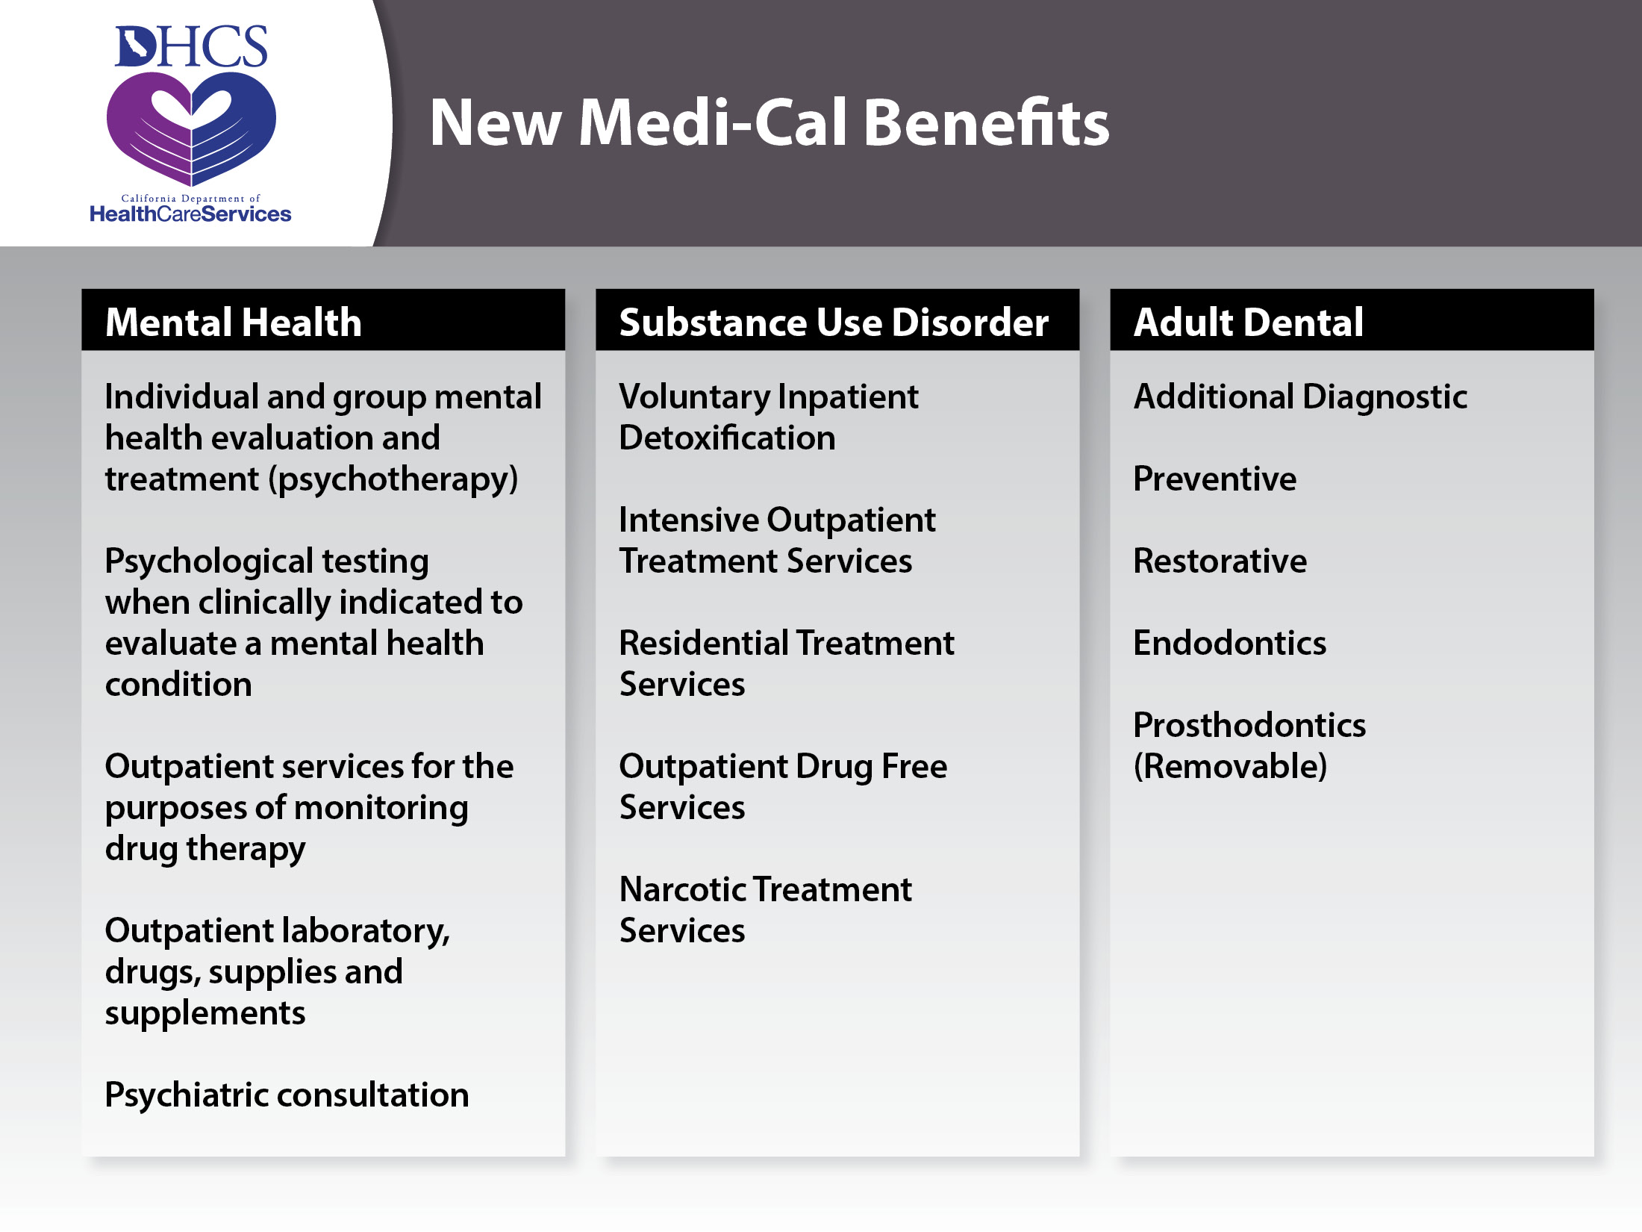
12

Slide 13
Covered California
Marketplace
13

Slide 14

Affordability =
Premium + Out-of-Pocket Expenses
For those not eligible for Medi-Cal:
Gross Premium rate is driven by
  Age of each adult being covered
  Household’s zip code
  Benefit plan selected
  For families, a separate rate is charged for the first
  three children under the age of 18. Adult children
  are counted separately
Net Premium rate is driven by
  Eligibility for premium assistance in the form of an
  Advance Tax Credit
14
Notes:
Rates for these health plans will vary by region, ZIP code, metal level, and age. The chart shows the regions as broken up by price across California. In each region, there are at least three different health insurance companies offering all 5 levels of coverage – Platinum, Gold, Silver, Bronze and Catastrophic – with many regions with more.

Slide 15
Premium rates influenced
by benefit plan
Plan pays an average percent of health care costs – ranging from 60% to 90%
Consumer Pays
Consumer Pays
Consumer Pays
Consumer Pays
Plan
Pays
Plan
Pays
Plan
Pays
Plan
Pays
Bronze⁶⁰
Silver⁷⁰
Gold⁸⁰
Platinum⁹⁰
Actuarial Value or AV is the expected percent coverage.
Gold has an AV of 80%
15
Notes:
Rates for these health plans will vary by region, ZIP code, metal level, and age. The chart shows the regions as broken up by price across California. In each region, there are at least three different health insurance companies offering all 5 levels of coverage – Platinum, Gold, Silver, Bronze and Catastrophic – with many regions with more.

Slide 16
Premium assistance eligible consumers pay “fair share” amounts regardless of age; the premium assistance makes up the difference
Fair Share payment + Premium Assistance =
Premium for 2nd Lowest Silver⁷⁰ plan
$600
$500
$400
$300
$200
$100
$639
Monthly Payment
Premium Assistance
from IRS
$183
$45
Fair Share payment
$45
$228 total premium $684 total premium
21 years old 64 years old
NOTE: Example reflects 2014 rates for Fresno using 2nd lowest priced Silver⁷⁰ plan
16
Notes:
Rates for these health plans will vary by region, ZIP code, metal level, and age. The chart shows the regions as broken up by price across California. In each region, there are at least three different health insurance companies offering all 5 levels of coverage – Platinum, Gold, Silver, Bronze and Catastrophic – with many regions with more.

Slide 17
The premium assistance is sensitive to age
Premium assistance is the difference between the actual premium and the consumers
“fair share” payment
$600
$500
$400
$300
$200
$100
Premium Assistance Zone
Premium Rate driven by age, family size, product, and location
Fair Share Payment = 3.5% of Household Income
21 years old 64 years old
17
Notes:
Rates for these health plans will vary by region, ZIP code, metal level, and age. The chart shows the regions as broken up by price across California. In each region, there are at least three different health insurance companies offering all 5 levels of coverage – Platinum, Gold, Silver, Bronze and Catastrophic – with many regions with more.

Slide 18
Reduced cost sharing improves affordability for many
In addition to the premium assistance that helps pay for the monthly premium, many consumers are also eligible for Enhanced Silver plans with very generous benefits to help pay for out-of-pocket costs.
“Platinum”
Level Coverage at
Silver Level Price
Silver⁹⁴
Silver⁸⁷
Silver⁷³
Silver⁷⁰
140% - 150% 150% - 200% 200% - 250% 250% - 400%
Income as Percent of Federal Poverty Level (FPL)
18
Notes:
Rates for these health plans will vary by region, ZIP code, metal level, and age. The chart shows the regions as broken up by price across California. In each region, there are at least three different health insurance companies offering all 5 levels of coverage – Platinum, Gold, Silver, Bronze and Catastrophic – with many regions with more.

Slide 19

19

Slide 20

Scenario 1: Zachary
Eligible for Premium Assistance
  Under 400% of the federal poverty level
Eligible for Cost-Sharing Subsidies
  Under 250% of the federal poverty level and enrolls in a Silver-Level Plan
20

Slide 21
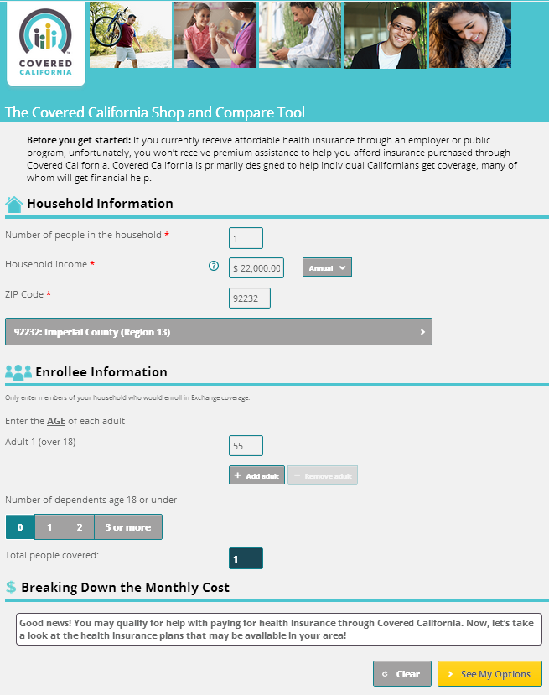
Zachary
Scenario 1: Eligible for Premium Assistance and Cost-Sharing Subsidies
Age: 55
Marital Status: Single
Annual Income*: $22,000
(~190% of the Federal Poverty Level)
Dependents: None
Pricing Region: 13
(Imperial County – Zip: 92232)
*Modified adjusted gross income
21

Slide 22
Quick summary of FPL ranges
Cost Sharing + Premium Assistance
Premium Assistance Only
Medi-Cal
Medi-Cal for Children
Number | Up to or at 138% | Over 138% | 150% | 200% | 250% | 400%
1 | $15,856 | $15,857 | $17,235 | $22,980 | $28,725 | $45,960
2 | $21,403 | $21,404 | $23,265 | $31,020 | $38,775 | $62,040
3 | $26,951 | $26,952 | $29,295 | $39,060 | $48,825 | $78,120
4 | $32,499 | $32,500 | $35,325 | $47,100 | $58,875 | $94,200
22
Notes:
Rates for these health plans will vary by region, ZIP code, metal level, and age. The chart shows the regions as broken up by price across California. In each region, there are at least three different health insurance companies offering all 5 levels of coverage – Platinum, Gold, Silver, Bronze and Catastrophic – with many regions with more.

Slide 23
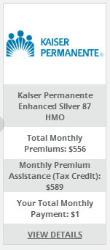
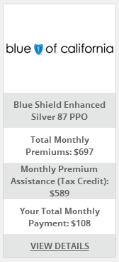
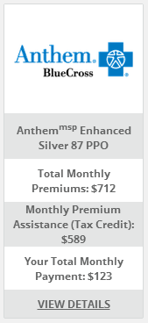
Zachary
Scenario 1: Eligible for Premium Assistance and Cost-Sharing Subsidies
ELIGIBLE FOR...
Age: 55
Marital Status: Single
Annual Income*: $22,000
(~190% of the Federal Poverty Level)
Dependents: None
Pricing Region: 13
(Imperial County – Zip: 92232)
*Modified adjusted gross income
Covered California Health Plan:
Under 400% FPL–Premium Assistance
Under 250% FPL–Cost-Sharing Assistance
23

Slide 24
Zachary
Scenario 1: Eligible for Premium Assistance and Cost-Sharing Subsidies
ELIGIBLE FOR...
Age: 55
Marital Status: Single
Annual Income*: $22,000
(~190% of the Federal Poverty Level)
Dependents: None
Pricing Region: 13
(Imperial County – Zip: 92232)
*Modified adjusted gross income
Covered California Health Plan:
Under 400% FPL–Premium Assistance
Under 250% FPL–Cost-Sharing Assistance
24

Slide 25
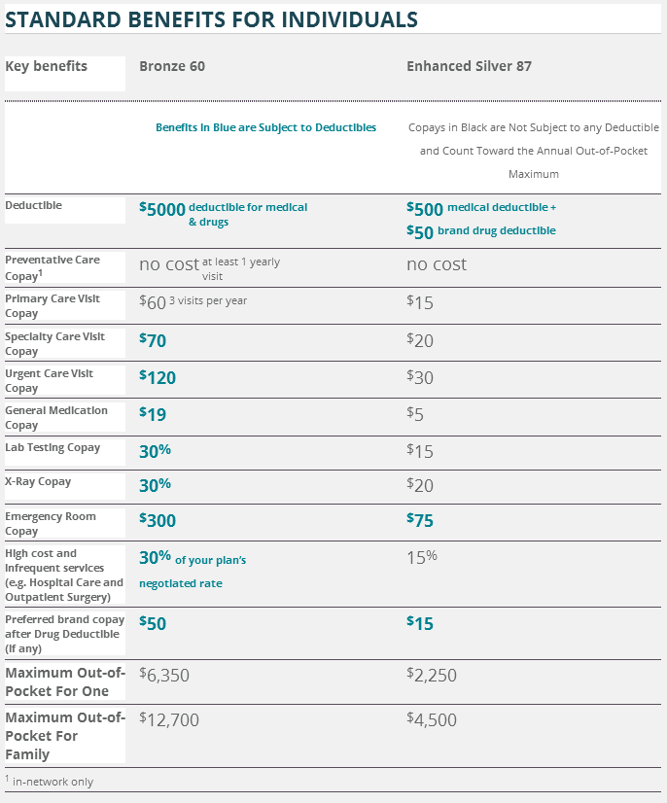
Zachary
Scenario 1: Eligible for Premium Assistance and Cost-Sharing Subsidies
25
ELIGIBLE FOR...
Age: 55
Marital Status: Single
Annual Income*: $22,000
(~190% of the Federal Poverty Level)
Dependents: None
Pricing Region: 13
(Imperial County – Zip: 92232)
*Modified adjusted gross income
Covered California Health Plan:
Under 400% FPL–Premium Assistance
Under 250% FPL–Cost-Sharing Assistance

Slide 26
Three Takeaways:
Must enroll in a Silver-level health plan to receive cost-sharing subsidies
Out-of-pocket costs (including maximum and deductible) become MUCH LOWER when a Silver-level health plan is “enhanced” with federal cost-sharing subsidies – for Zachary, 87% of his out-of-pocket costs will be paid by a Silver-level health plan (vs. 60% if selected a Bronze-level health plan)
How much the plan is “enhanced” is shown by the number next to the metal tier, “Enhanced Silver 87”
Three Takeaways
26

Slide 27
Minimum Coverage Plan
“catastrophic coverage plan”
Offers the same benefits as other plans, but at
a much lower monthly premium and much higher out-of-pocket costs (~50/50 AV)
If selected, you cannot receive premium assistance or cost-sharing subsidies, even if eligible
Eligible for Minimum Coverage Plan if:
  Under age 30; or
  Receive a hardship exemption from Health & Human Services because lowest-cost Bronze plan is more than 8% of MAGI income.
27

Slide 28

Scenario 2: The Martins
Multiple Program Family
  Adult (Diane)
    Eligible for Premium Assistance
    Under 400% of the federal poverty level
    Eligible for Cost-Sharing Subsidies
    Under 250% of the federal poverty level
    and enrolls in a Silver-Level Plan
  Child (Wendy)
    Eligible for Medi-Cal Under 250% of the federal poverty level
28

Slide 29
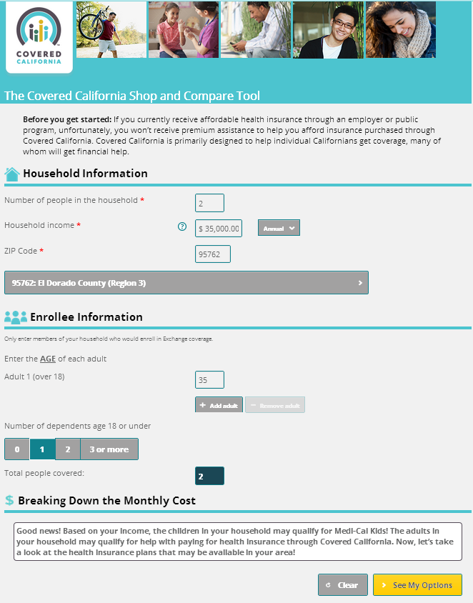

The Martins
Scenario 2: Multiple Program Family – Child Eligible for Medi-Cal, Mother Eligible for Covered CA
Age: Diane, 35
Marital Status: Single
Dependent Children (Wendy): 1
Annual Income*: $35,000
(~225% of Federal Poverty Level)
Pricing Region: 3
(El Dorado – Zip: 95762)
*Modified adjusted gross income

Slide 30

The Martins
Scenario 2: Multiple Program Family – Child Eligible for Medi-Cal, Mother Eligible for Covered CA
Age: Diane, 35
Marital Status: Single
Dependent Children (Wendy): 1
Annual Income*: $35,000
(~225% of Federal Poverty Level)
Pricing Region: 3
(El Dorado – Zip: 95762)
*Modified adjusted gross income
30

Slide 31
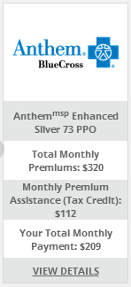
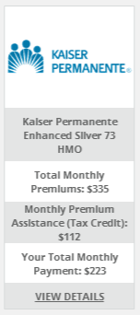
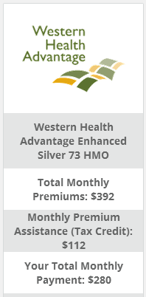

The Martins
Scenario 2: Multiple Program Family – Child Eligible for Medi-Cal, Mother Eligible for Covered CA
Diane (Adult) will be eligible for:
Covered California Health Plan:
Under 400% FPL–Premium Assistance
Under 250% FPL – Cost-Sharing Subsidies
Age: Diane, 35
Marital Status: Single
Dependent Children (Wendy): 1
Annual Income*: $35,000
(~225% of Federal Poverty Level)
Pricing Region: 3
(El Dorado – Zip: 95762)
*Modified adjusted gross income
Not shown: Blue Shield of California PPO, $210;
Anthem Blue Cross HMO, $348
Wendy (Child) will be eligible for Medi-Cal
31

Slide 32
The Martins
Scenario 2: Multiple Program Family – Child Eligible for Medi-Cal, Mother Eligible for Covered CA
Diane (Adult) will be eligible for:
Covered California Health Plan:
Under 400% FPL–Premium Assistance
Under 250% FPL – Cost-Sharing Subsidies
Age: Diane, 35
Marital Status: Single
Dependent Children (Wendy): 1
Annual Income*: $35,000
(~225% of Federal Poverty Level)
Pricing Region: 3
(El Dorado – Zip: 95762)
*Modified adjusted gross income
Not shown: Blue Shield of California PPO, $210;
Anthem Blue Cross HMO, $348
Wendy (Child) will be eligible for Medi-Cal
32

Slide 33




The Martins
Scenario 2: Multiple Program Family – Child Eligible for Medi-Cal, Mother Eligible for Covered CA
Wendy (Child) will be eligible for Medi-Cal
Age: Diane, 35
Marital Status: Single
Dependent Children (Wendy): 1
Annual Income*: $35,000
(~225% of Federal Poverty Level)
Pricing Region: 3
(El Dorado – Zip: 95762)
*Modified adjusted gross income
$13
$13
$13
Through Medi-Cal for Families, Wendy will also be eligible for:
33

Slide 34
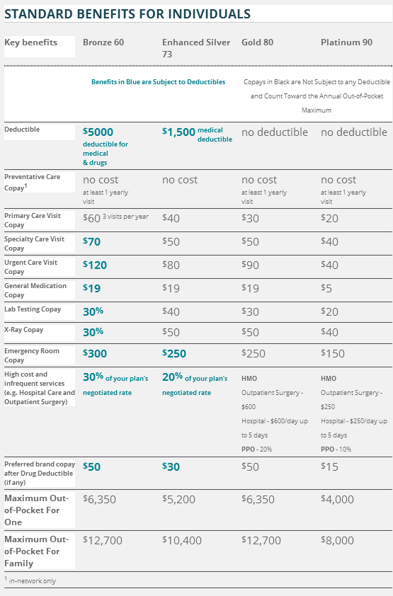
The Martins
Scenario 2: Multiple Program Family – Child Eligible for Medi-Cal, Mother Eligible for Covered CA
Covered California Standard Benefits:
Age: Diane, 35
Marital Status: Single
Dependent Children (Wendy): 1
Annual Income*: $35,000
(~225% of Federal Poverty Level)
Pricing Region: 3
(El Dorado – Zip: 95762)
*Modified adjusted gross income
34

Slide 35

35

Slide 36
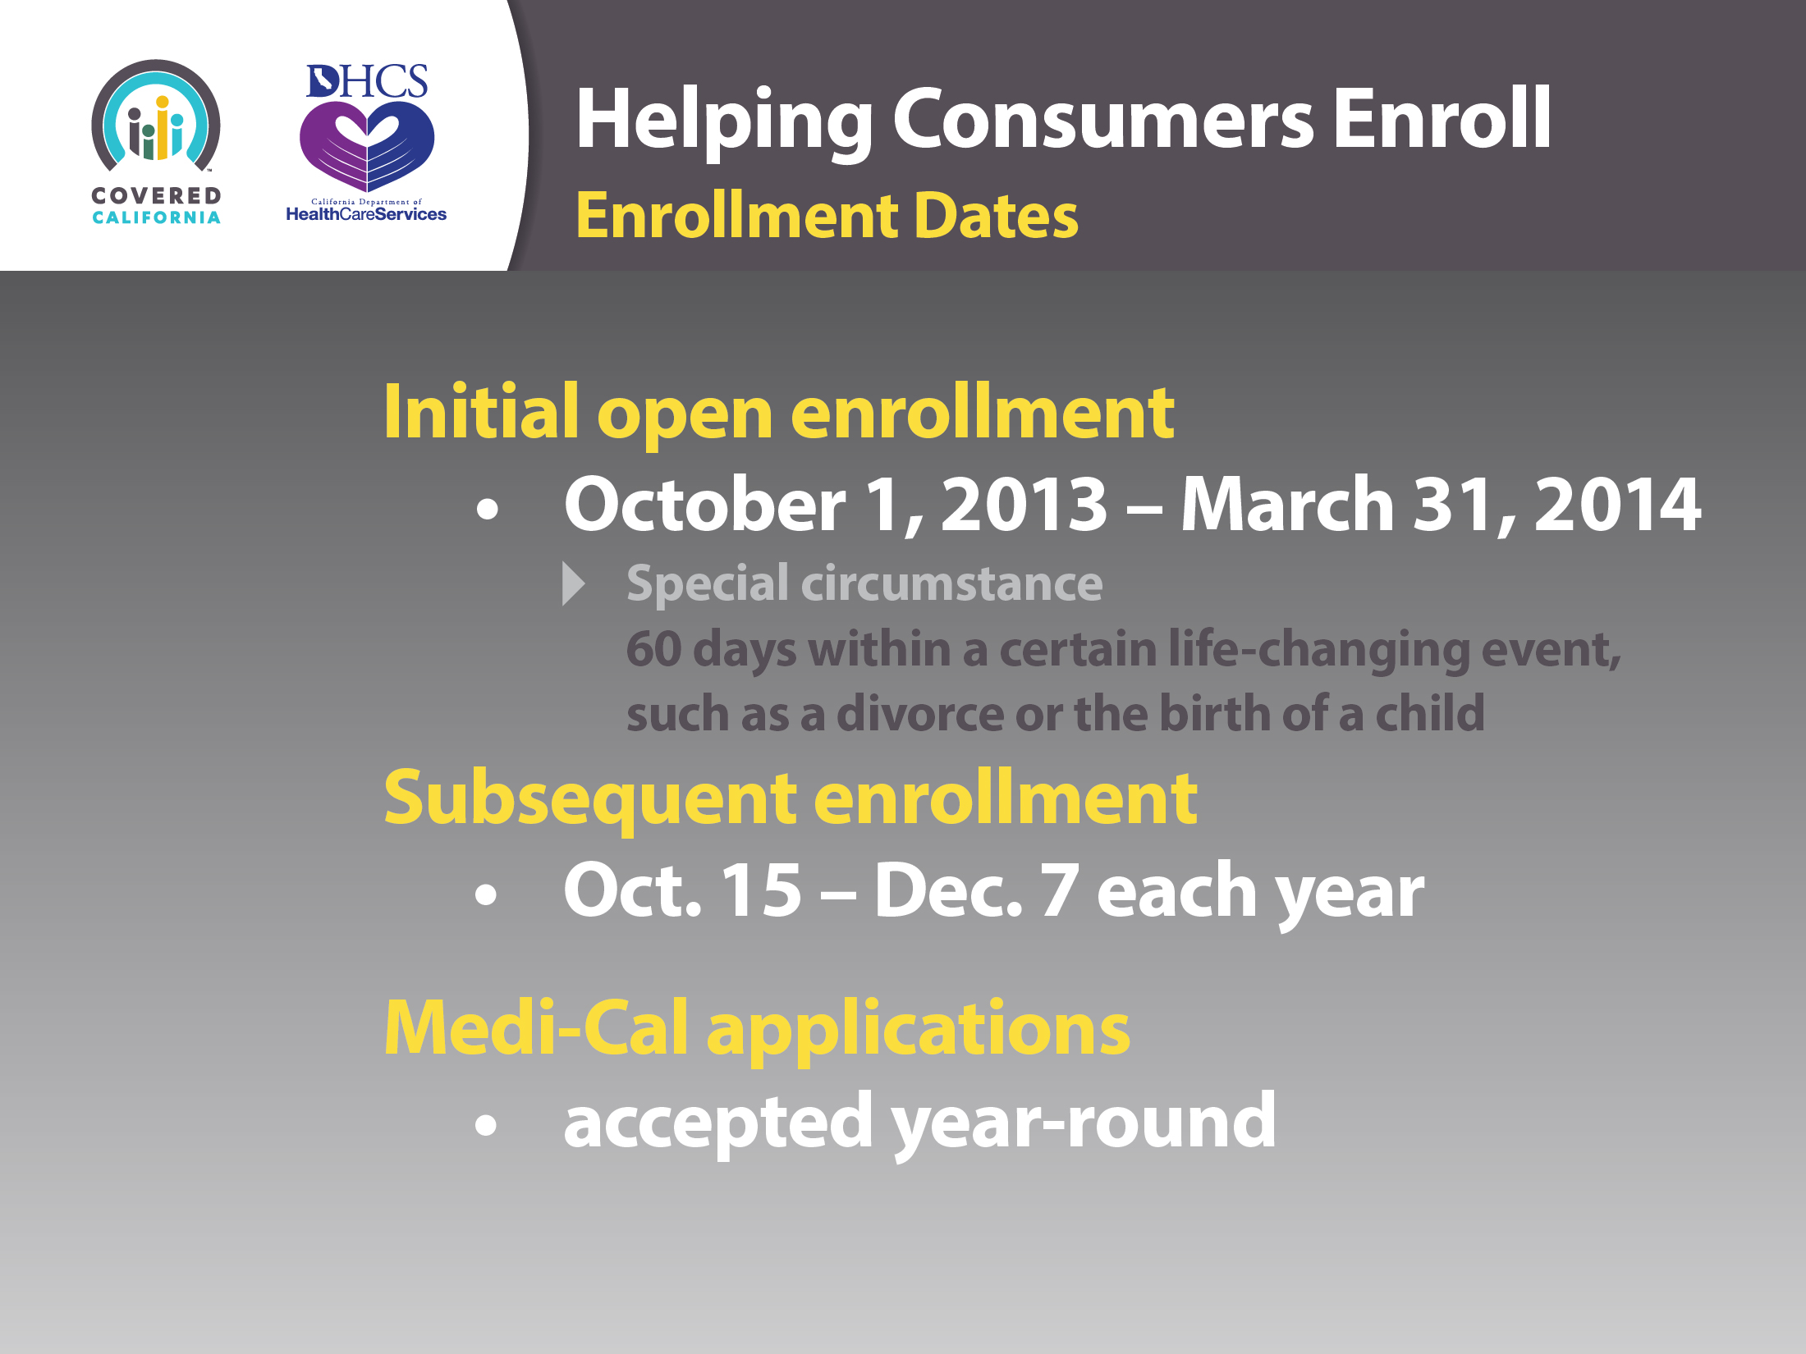
36

Slide 37

37

Slide 38
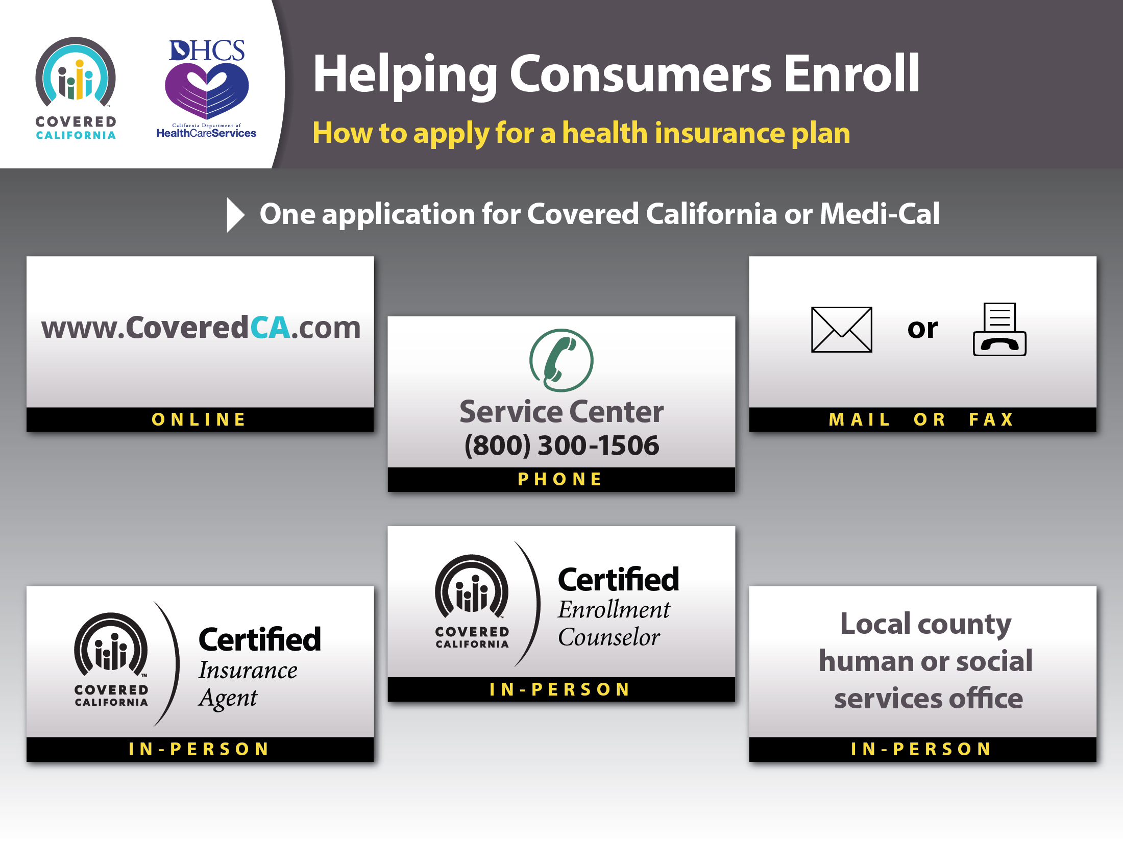
38

Slide 39

39

