Slide 2
WELCOME
Navigator Kickoff
Webinar FY 17/18
August 31, 2017
Closed Captioning
Notes:
Welcome and Congratulations on being awarded for the 2017-2018 Navigator Grant Program. This webinar is brought to you by the Navigator Account team with Covered California. Please note the hyperlink at the bottom of this slide. If anyone is in need of closed captioning, click the link, and a new page will open for you. After the webinar is concluded a recording as well as a transcript of the closed captioning will be available to download.
Ben Walker introduction

Slide 3
AGENDA
Review of important dates
Preparing for Open Enrollment
Program administration
What’s new
Resources
Question and answer
Notes:
(Insert Ben’s introduction if needed)

Slide 4

IMPORTANT DATES
Contract Agreement
September 1, 2017 through August 31, 2018
Submit your work-plan within 30 days of the executed agreement, by September 29, 2017.
OE 2018 Kickoff Meetings
Various dates and locations from September 6 - October 3, 2017
Renewal Begins
Mid October - December 15, 2017
Open Enrollment
November 1, 2017 - January 31, 2018 in California
Notes:
These are important dates for you to note.
The full term of your agreement is September 1, 2017 through August 31, 2018.
You are strongly encouraged to attend the (Open enrollment 5) OE5 kick off meetings in your area. The kick off meetings will provide valuable reminders and important open enrollment updates. You should have received an invitation via email on the locations and dates to attend in your area. If you have not yet registered, please do so. If you did not receive an invitation please contact your assigned Account Representative for assistance 2018.
Renewal begins early October through December 15th. This date is typically the same every year.
Open enrollment is scheduled for November 1 2017 though January 31 2018 in California. (Opposed to November 1-December 15 2017 through the the National exchange)

Slide 5
OPEN ENROLLMENT
Notes:
Reminder

Slide 6
PREPARING FOR OPEN ENROLLMENT
Review your storefronts for accuracy
  Location
  Hours of operation
Certify or recertify CECs
Familiarize yourselves with the IPAS Replacement Portal
  Uploading of documents
  Basic Navigation for Entity vs. Counselor
Familiarize yourselves with the work-plans we have agreed on
Notes:
Listing of items you want to review and

Slide 7
OPEN ENROLLMENT KICK OFF MEETING SCHEDULE
Week 1 Sept. 6 – Anaheim Sept. 7 – Santa Rosa Sept. 8 – Redding | Week 2 Sept. 11 – Modesto Sept. 12 – Clovis Sept. 13 – San Luis Obispo Sept. 14 – Watsonville Sept. 15 – San Francisco
Week 3 Sept. 19 – San Diego Sept. 20 – Escondido Sept. 21 – Rancho Cucamonga Sept. 22 – Indio | Week 4 Sept. 26 – Oxnard Sept. 27 – San Fernando Sept. 28 – Whittier Sept. 29 – Torrance Week 5: October 3rd Tuesday – Sacramento - Sacramento County
Notes:
Open enrollment 2018. Your attendance is strongly encouraged. You will receive:
Program and administrative updates
Collateral materials

Slide 8
PROGRAM ADMINISTRATION

Slide 9
WORKPLAN AND CAMPAIGN STRATEGY
Submitted within 30 days after activation of agreement
Grantee must complete this worksheet to:
  demonstrate their capability
  and that of their subcontractors, if applicable
  and reach and enroll the number of individuals listed in the Amendment 2
Notes:
Your account managers will be working closely with you based on the work plans you have provided to ensure your goals are met. Its crucial that your work plan and campaign strategy is up to date.

Slide 10
PROGRESS REPORTS
Due Dates
Bi-Monthly Progress Reports
Reporting Months | Report Due Dates
September-October 2017 | November 1-10, 2017
November-December 2017 | January 1-10, 2018
January-February 2017 | March 1-10, 2018
March-April 2017 | May 1-10, 2018
May-June 2018 | July 1-10, 2018
July-August 2018 | September 1-30, 2018
Notes:
During this term of the agreement progress reports must be submitted Bimonthly as listed in your agreement. Reports should be uploaded to IPAS in my files. If you are unable to complete your progress reports by the due date, please inform your account manager prior to the due date.

Slide 11
PAYMENT REQUESTS
Submission Dates
Timeline | Payment | Award % Paid
October 1-10, 2017 | 20% of award | 20%
December 1-10, 2017 | 20% of award | 40%
February 1-10,2018 | 20% of award | 60%
May 1-10, 2018 | 20% of award | 80%
June 1-15, 2018 | 20% of award | 100%
Notes:
You may submit your payment request form on the 1st day of the scheduled month to the Navigator program inbox at Navigator program@covered.ca.gov. You cannot submit prior to this date or your remittance will be returned. For example if your payment is due on October 10th you cannot submit the remittance prior to October 1st .

Slide 12
CERTIFICATION
  Certification/Recertification training available on September 7, 2017 and all counselors are enrolled
  Required to complete 17/18 even if you completed 16/17 version
  After you receive your access and instructions email from CCU, open training in Firefox or Chrome.
  Training provides program regulatory administrative updates
  Recommend not completing 16/17 training prior to 17/18 release.
  Newly hired CECs need to complete, prior to enrolling
  Decertification deadline to complete and pass is December 31, 2017, no extensions.
  Training Help Desk: CCULearning@covered.ca.gov.
Notes:
Law and regulation requires all CECs to complete an annual training course that provide program updates e.g., laws or administrative processes. We recommend that newly certified or hired CECs delay the certification training until the new certification training is available in September. This strategy would avoid CECS from having to take the expired course and being required to complete the new course.

Slide 13
MANAGEMENT MEMORANDA
The purpose of the Management Memoranda are:
  To clarify administrative instructions
  To define process and procedure
  To clarify processes and procedure
Notes:
Look for management memos that are designed to provide instruction or clarification regarding a n administrative program procedure or process.
Issued as necessary

Slide 14
EVENT REPORTING
Event Portal events should be:
  Open to the public
  Location and hours clearly identified
  Located on the Navigator home page under “Outreach” and titled, “Event Proposal Portal”
  Your entity name is identified in the “Event Name” or “Host Organization” field
    Name may appear in parenthesis e.g., (Covered California)
Direct help questions to: Events@covered.ca.gov.
.
Notes:
Must be open to the public;
Location and hours are clearly identified;
The complete Navigator Grant Program entity name is clearly identified in either the “Event Name” or “Host Organization” field; and
The entity name can be in parenthesis, identified as in partnership with another entity if it is not the sole host of the event, etc., as long as the entity’s entire name is present in either of the “Event Name” or “Host Organization” fields.
This allows the Grantee’s Account Services Representative or Specialist to locate the events you enter in the portal as required in your Agreement [Exhibit A(C)(3)].

Slide 15
STOREFRONTS
We encourage you to review current storefront information:
    Locations
    Days and times of operation
    Contact Information
Storefront Program Application:
http://storefronts.coveredca.com/BecomeAStorefront/
Storefront Finder:
http://storefronts.coveredca.com/
E-Mail:
Storefront@covered.ca.gov
Notes:
You can get additional information from the links provided

Slide 16

SITE VISITS
Observations from recent compliance visits
  PII Forms – oral authorization not identified
  Missing signatures
Law and regulation requires consumer authorization before engaging in enrollment activities
Notes:
As part of your agreement. We will be conducting one Compliance Site Visit after open enrollment closely mirroring last years review. The date is still to be determined. Your account manager will contact you to schedule a date and time.
Two per year
Prior to Open Enrollment
Contract Compliance (end of Open Enrollment)
Observations gathered from visits

Slide 17
WHAT’S NEW

Slide 18
Salesforce: IPAS Replacement
Completion of the new Certification Portal scheduled for late September 2017
Please review, update, and confirm your Entity information is accurate
Contains: required docs, entity and sub info, and my files
Promises to be an effective replacement for IPAS
  Greater access and control for entities and CECs
Instructions and aids are being developed
Contact CCCertificationServices@covered.ca.gov for certification portal related questions and help.
Notes:
Thoughts from Shirley?

Slide 19
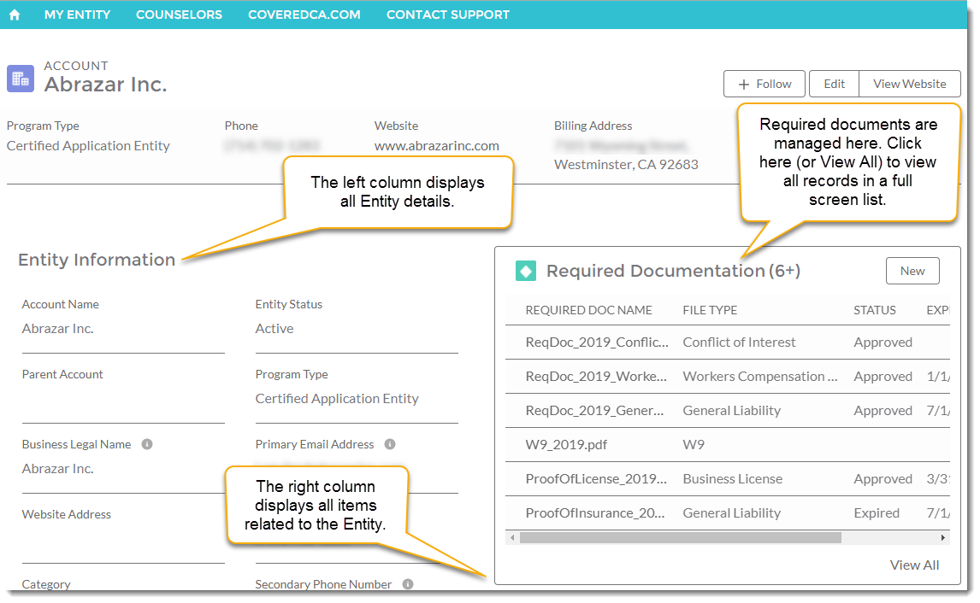
Salesforce: IPAS Replacement (continued)
“My Entity” homepage (Entity View):
Notes:
Thoughts from Shirley?

Slide 20
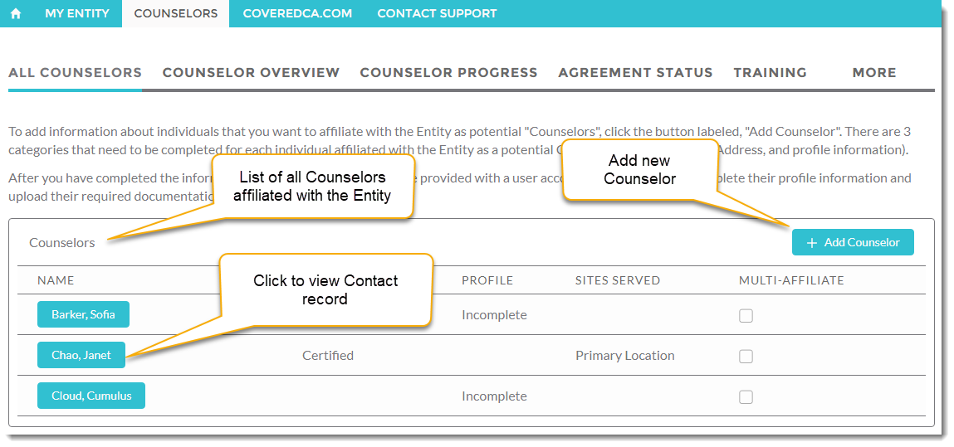
Salesforce: IPAS Replacement (continued)
Click on the “Counselors” tab (Entity View):
Notes:
Thoughts from Shirley?

Slide 21
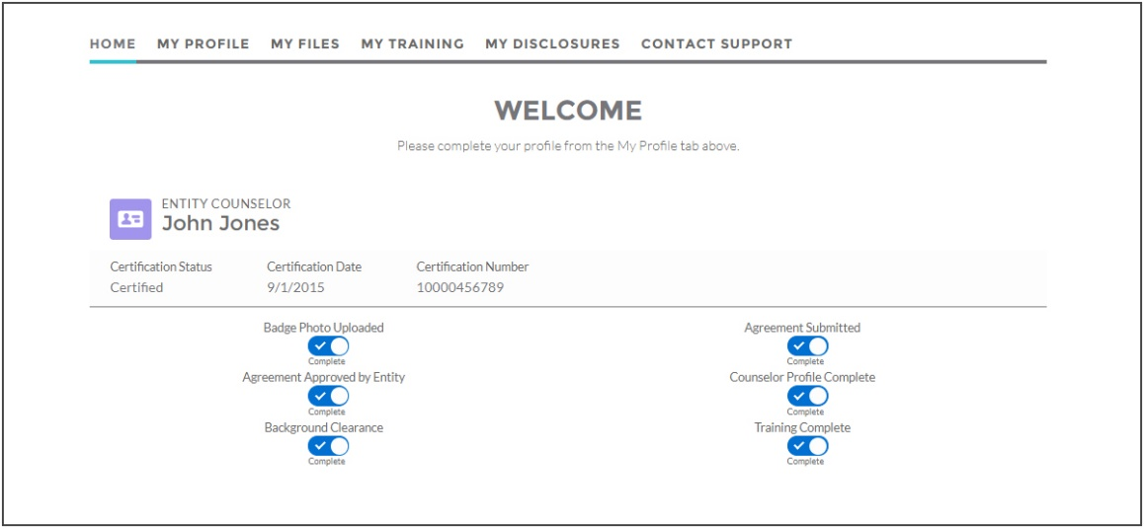
Salesforce: IPAS Replacement (continued)
“Counselor” homepage (Counselor View):
Notes:
Thoughts from Shirley?

Slide 22
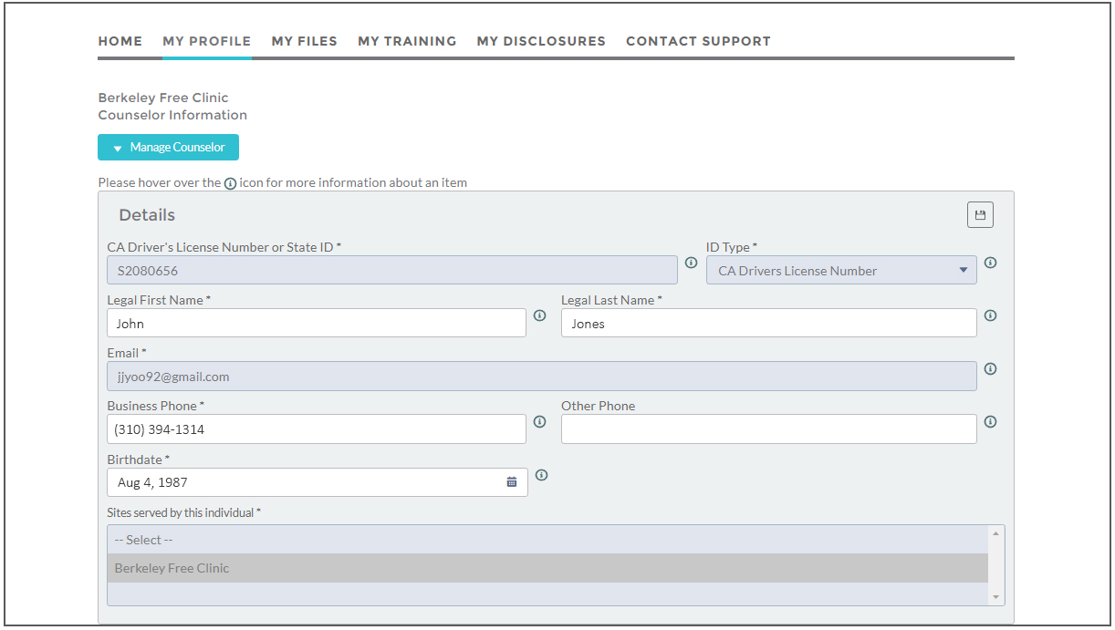
Salesforce: IPAS Replacement (continued)
“My Profile” tab to view/confirm your info (Counselor View):
Notes:
Thoughts from Shirley?

Slide 23
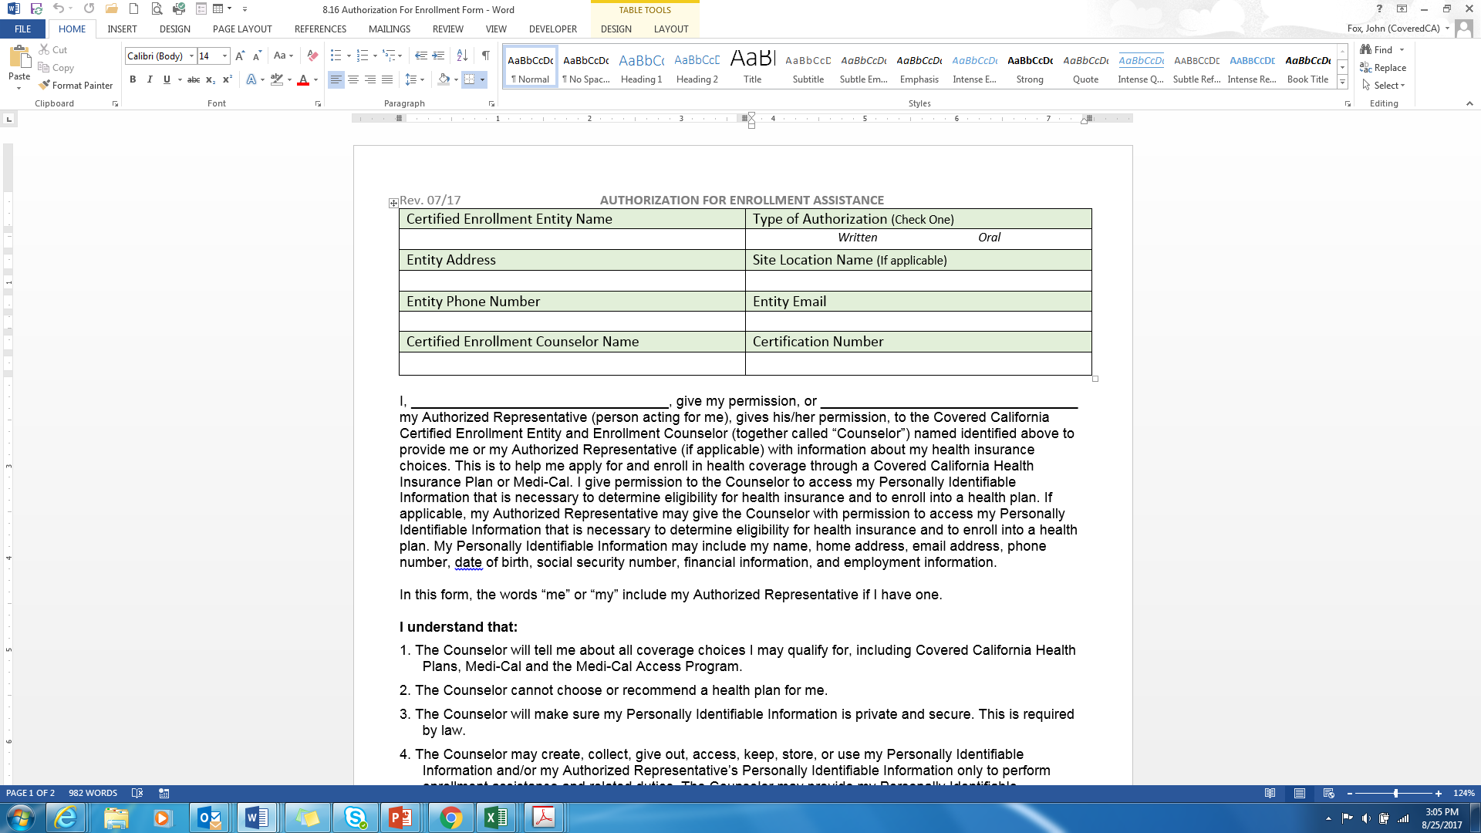
NEW PII AUTHORIZATION FORM
Permits:
  Identification of oral authorization from consumers on the top of page 1.
Authorization for enrollment form
Notes:
As a result of the compliance site visits the Accounts Team discovered a serious program compliance concerns. Authorization forms signed by the consumer authorizing a CEC access to the consumer’s personal identifiable information (PII) is REQUIRED by law and regulation. CECs should review the authorization with the consumer BEFORE engaging in any health enrollment activity. If the contact with the consumer takes place via phone the contact should documented on the revised authorization form .
The form can be access via the Navigator webpage
The properly completed form should be signed by the consumer and MUST be filed and retained for 10 years by the entity in a secured manner e.g., locked file cabinet or in an encrypted electronic file system.

Slide 24
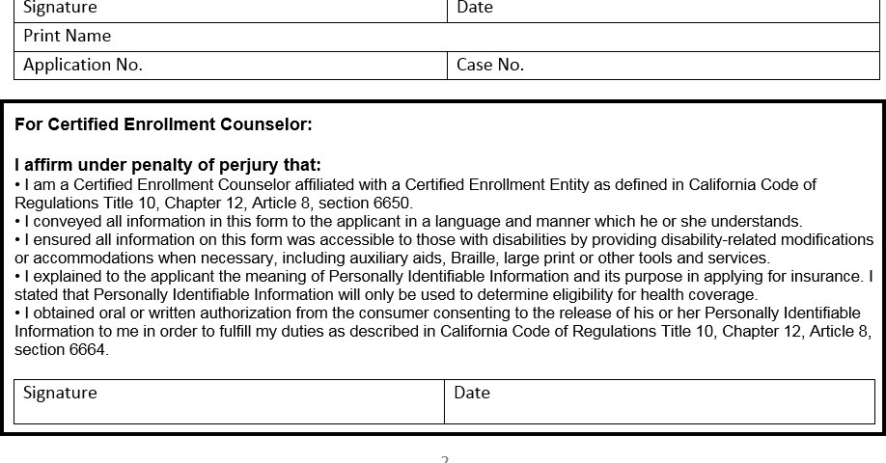
NEW PII AUTHORIZATION FORM (Continued)
Case number field
Notes:
The case number of the consumer, the consumer’s signature, the date of signature, the name of the consumer printed, and the application number should be recorded on the second page of the authorization form
The CEC signs and dates an authorization form for each consumer they have engaged in enrollment activities.

Slide 25
BI-MONTHLY CALLS
To enhance our customer service commitment to you, we will contact you:
  October 2017 through February 2018
  Twice a month (every two weeks)
  Scheduled at a time convenient for you
  We will review:
    Program updates
    Technical assistance concerns
    Progress reports
    Anything you wish to discuss
Notes:
Beginning in October we will begin contacting you on a biweekly basis to do check in’s and provide support for renewals and open enrollment.
Calls will be twice a month to run from October through February
Your account rep will reach out to schedule a date and time for your calls.

Slide 26
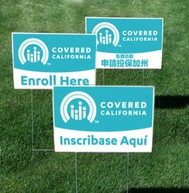
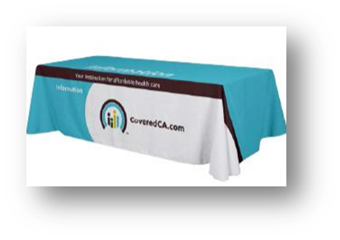
COLLATERAL
New process: Acquiring collateral material has been centralized
  Your Account Representative has been allocated a collateral budget to support their grantees
  The budgeted amount will be available to you through your representative
    Request desired materials via email. Cite the item number, quantity, size, and any customization
    The representative will approve or deny the request
    The Account Representative will notify the grantee that the request has been approved (or denied) and place the order behalf of the grantee
    Notify grantee when order can be anticipated to be received
  Note: You can purchase on your own with your credit card
http://360.kpcorp.com/coveredca
Notes:
New collateral material will be available by mid September. Please contact Darlene Murphy if you have any questions. Her contact information is located on the slides provided earlier.. If you would like to create your own collateral please be sure to follow the Covered CA branding guidelines. and run it through your assigned analyst.
Reminder to use appropriate branding guideline defined in the branding guide. The guide may be accessed via the HBEX webpage.
The link on this slide will provide the branding guidelines. If you need assistance reach out to your analyst
The process for accessing collateral material has been centralized
Your Account Representative has been allocated a $6,500 budget for collateral to support the grantees they support
The budgeted amount will be available to you through your representative
Request desired materials via email. Cite the item number, quantity, size, and any customization.
The representative will approve or deny the request
The Account Representative will notify the grantee that the request approval (or denial) and place the order behalf of the grantee
Notify grantee when order can be anticipated to be received

Slide 27
PRODUCTIVITY REPORTS
To receive credit towards your enrollment numbers during Renewal Period you need to:
  Run Eligibility Determination for the consumer
  Be “Active” in the Renewal Process
  To receive credit towards your enrollment numbers during Open Enrollment Period you need to:
    Ensure that you are delegated to the consumer
    Make a plan selection for the consumer
Notes:
Beginning in October we will begin contacting you on a biweekly basis to do check in’s and provide support for renewals and open enrollment.
Calls will be twice a month to run from October through February
Your account rep will reach out to schedule a date and time for your calls.

Slide 28
PROGRAM TIMELINE
Aug 2017
Contract Extension Begins
Board Meeting
Sept 2017
OE 2018 Kickoff Meetings
Oct 2017
Nov 2017
OE 2018 Begins
Dec 2017
Renewal Period Ends
Jan 2018
OE 2018 Ends
Storefront Cleanup
Renewal Period Begins
Feb 2018
Mar 2018
April 2018
June 2018
July 2018
Board Meeting
Board Meeting
Contracts w/new grantees
Being RFA Process
SEP Begins
SEP Meetings
Contract Compliance Site Visits
Board Meeting
Notes:
A timeline has been created to provide you with important program dates for the term of the 2017-2018 program year e.g., due dates for reports or payment requests.
Will be posted on Navigator webpage

Slide 29
RESOURCES

Slide 30
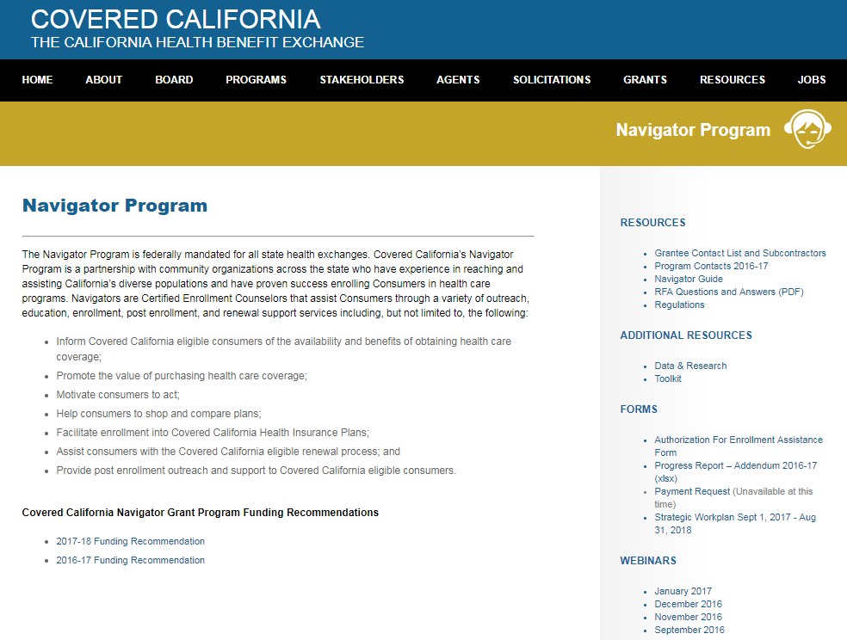
HBEX WEBPAGE
What’s new
Grantee Contact and Sub List Funding Recommendations Authorization Form With more updates Forthcoming.
Notes:
Note all new information; changes.

Slide 31
PARTNER TOOLKIT
Notes:
Covered California provides various beneficial resources for our partners.
Please familiarize your self with the partner toolkit especially the webinars. They provide great information, updates and changes to Covered CA and the Outreach and Sales Division
Visit www.CoveredCA.com
In the footer click Enrollment partners
Click Partner toolkit
Click webinars and briefings
Then download.
.

Slide 32




SOCIAL MEDIA
https://www.facebook.com/CoveredCA
https://www.youtube.com/user/CoveredCA
  https://twitter.com/coveredca
https://instagram.com/coveredca/?hl=en
Notes:
Social media has proven to serve as a very strong platform for a lot of grantees in the past. Partners have expressed the success they have experienced utilizing social media when it comes to advertising events.
Some of the most widely-used social media applications are listed on the slide with the links to Covered California’s accounts.
You can view the content posted by our marketing and communications teams through social media and mirror your posts.

Slide 33

ADDITIONAL RESOURCES
https://www.healthcare.gov/
Federal Health Exchange website useful for definitions and scenarios.
Covered California homepage http://www.coveredca.com/
.
http://www.coveredca.com/get-help/local/
The Find Local Help webpage that directs consumers to storefronts and events
The Navigator Grant Program homepage
http://hbex.coveredca.com/navigator-program/
The Find a Storefront Near You webpage where consumers can search all storefront listings
http://www.coveredca.com/get-help/local/storefronts/
E-mail address used for all Storefront inquiries
Storefront@covered.ca.gov
E-mail address used for all Event inquiries
Events@covered.ca.gov
Event Proposal Portal where events can be entered
https://coveredca.custhelp.com/app/events/admin/propose
Social media
(916) 206-1777
Covered California Learning Management System
https://learning.coveredca.com
CEC Helpline
(855) 324-3147
Assembly Bill 2706 on health education in schools
http://www.leginfo.ca.gov/pub/13-14/bill/asm/ab_2701-2750/ab_2706_cfa_20140623_173022_sen_comm.html
Background check
https://oag.ca.gov/fingerprints
http://hbex.coveredca.com/toolkit/
Renewal toolkit
Covered California Co-Branding Style Guide
http://hbex.coveredca.com/PDFs/style-guides/CC_BrandStyleGuide_External.pdf
Storefront Application
http://storefronts.coveredca.com/BecomeAStorefront/

Slide 34
PROGRAM STAFF
Benjamin Walker Section Chief, Accounts Services Team Benjamin.walker@covered.ca.gov (916) 228-8256 | Tonya Thomas Account Services Specialist Los Angeles Tonya.Thomas@covered.ca.gov (916) 228-8227
Jasmine Andrade Account Services Representative Los Angeles Jasmine.Andrade@covered.ca.gov (916) 228-8494 | Blake A. Deering Account Services Representative Central Valley / Bay Area Blake.Deering@covered.ca.gov (916) 228-8773
John Fox Account Services Representative Northern California / Central Coast John.Fox@covered.ca.gov (916) 228-8772 | Shirley Swedlow Account Services Representative San Diego / Orange County / Inland Empire Shirley.Swedlow@covered.ca.gov (916) 228-8529

Slide 35



QUESTIONS
Notes:
Questions

