Slide 1

Covered California Programs and Benefits for American Indians and Alaska Natives

Slide 2
Covered California Overview

Slide 3
Major Changes to the Health Care System Because of the Affordable Care Act
Before the Affordable Care Act Today
Many consumers denied coverage by insurers because of pre-existing conditions. | Guaranteed coverage for all — no screening or price differences due to health status.
Many consumers with insurance bankrupted by gaps in coverage and annual or lifetime limits. | Insurers are prohibited from setting lifetime limits on essential health benefits, such as hospital stays.
Health coverage unaffordable for millions without employer coverage — except the healthy (underwritten) and wealthy (those making enough to foot the bill) | Subsidies making coverage affordable to 9 million Americans; millions more have affordable options through Medicaid expansion, 7 million unsubsidized struggling with rising costs.
Insurers could remove young adults from their parents’ policies, leaving them uninsured. | Dependent children up to age 26 must be offered coverage under a parent’s insurance plan.
Children under 19 could be denied coverage because of a chronic condition. | Insurers may not exclude children under the age of 19 from coverage due to a pre-existing medical condition.
Medicaid only covered low-income children, pregnant women, elderly and disabled individuals, and some parents, but excluded other low-income adults. | For Medicaid expansion states, Medicaid covers all adults under 65 with income up to 133 percent on the federal poverty level.

Slide 4
FEDERAL REFORMS UNDER THE AFFORDABLE CARE ACT
Health Benefit Exchanges and Federal Subsidies:
Federal and state-based marketplaces to buy health insurance and receive financial assistance.
Insurance Market Reforms:
Guaranteed issue and renewal; no annual or lifetime limits;
coverage for essential health benefits; and dependent coverage up to age 26
Medicaid Expansion:
Inclusion of low-income childless adults.
Individual/Employer Mandate:
Most U.S. citizens and legal residents required to have health coverage.
*Beginning in 2019, the individual mandate tax penalty is reduced to $0.

Slide 5
ESTABLISHMENT OF THE CALIFORNIA HEALTH BENEFIT EXCHANGE (COVERED CALIFORNIA)
California was first state in nation to enact legislation creating a health benefit exchange under the Affordable Care Act
  Assembly Bill 1602 (Pérez, 2010) - California Patient Protection and Affordable Care Act in California
  Senate Bill 900 (Alquist, 2010) established structure and requirements for the state’s health benefit exchange
Independent public entity, governed by a five-member Board:
  Two members appointed by the Governor
  One member appointed by Senate Rules Committee
  One member appointed by Speaker of the Assembly
  Secretary of the California Health and Human Services Agency - ex-officio, voting member
Self-sustaining entity – no monies from the state General Fund

Slide 6
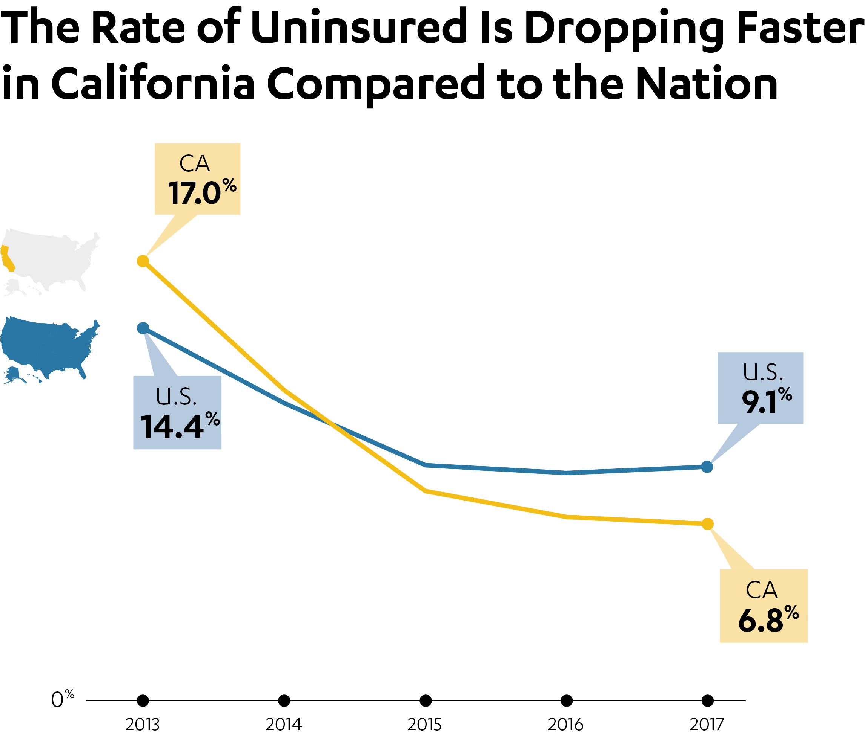

COVERAGE EXPANSION IMPACT
Covered California has served 3.5 million Californians since 2014. Today, 1.4 million consumers are actively enrolled, making Covered California the largest state-based marketplace in the country.
More than five million Californians have enrolled in California’s expanded Medi-Cal program.
Result of Medi-Cal expansion, and Covered California; eligible uninsured rate only 3.4%
Source: U.S. Centers for Disease Control and Prevention’s National Health Institute Survey

Slide 7
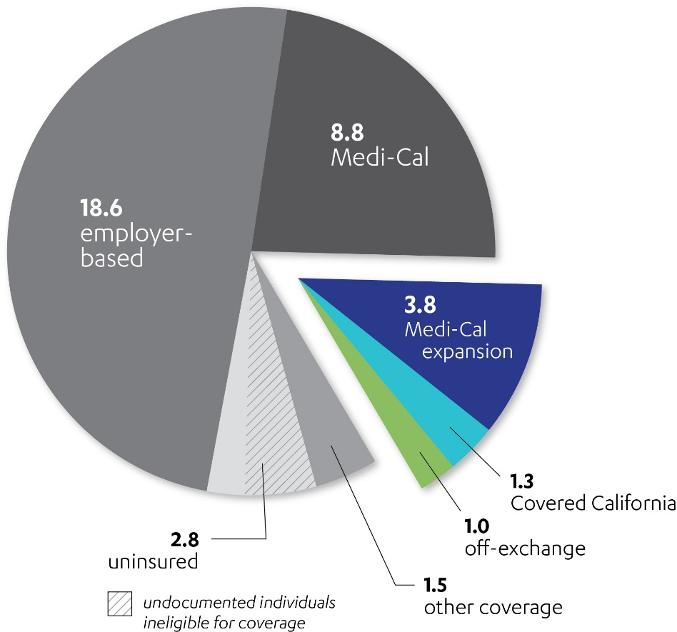
CALIFORNIAN’S OPPORTUNITIES FOR COVERAGE
The Affordable Care Act has dramatically changed the health insurance landscape in California with the expansion of Medicaid, Covered California and new protections for all Californians.
California’s 2017 Health Care Market
(in millions — ages 0-64)
As of June 2018, Covered California had approximately
1.4 million members who have active health insurance. California has also enrolled nearly 4 million more into
Medi-Cal.
Consumers in the individual market (off-exchange) can get identical price and benefits as Covered California enrollees.
From 2013 to 2017, the U.S. Census Bureau states California cut its uninsured rate by 58 percent. Accounting for those ineligible because of their immigration status, California’s eligible uninsured population is 1 million.
California administrative data sources are used for enrollment totals when possible. All other enrollment estimates are from the 2017 American Community Survey. The total enrollment population sums to more than California’s total population as some Californians were covered by more than one type of insurance during the same year.

Slide 8
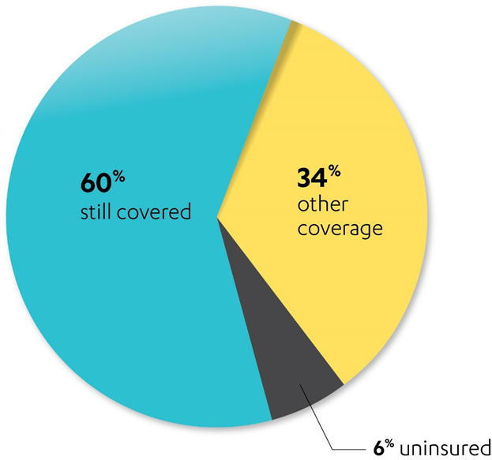
ANNUALLY, APPROXIMATELY FORTY PERCENT OF THE COVERED CALIFORNIA INDIVIDUAL MARKET TURNS OVER*
While Covered California’s consumers experience a high level of coverage transitions, nearly
85 percent of those who leave Covered California report transitioning to other coverage.
Prior to 2014, Covered California forecasted that about one-third of enrollees would leave coverage on an annual basis.
During 2015, Covered California covered 1.6 million unique members for at least one month.
By early 2016, approximately 40% of those 1.6 million (over 600,000) had ‘disenrolled’.
Of those who left Covered California, most went to employer-based coverage (50%).
California’s Health Care Coverage Transitions
(2016 Survey)
* Based on a recently completed Covered California 2016 survey of members (n=8,773) who left (“disenrolled”), the vast majority left for employer-based or other coverage.

Slide 9
8
8
More committed than ever
To our mission to increase the number of insured Californians, to improve health care quality, lower costs and reduce health care disparities across California
  More than 4 million people have been insured by Covered California since 2014
  More than 6 million people have been insured in the individual market both on and off-exchange
    More than 3.8 million people are currently enrolled in Medi-Cal because the Affordable Care Act’s expansion of Medicaid
6
MORE
THAN
MILLION CONSUMERS
SERVED

Slide 10
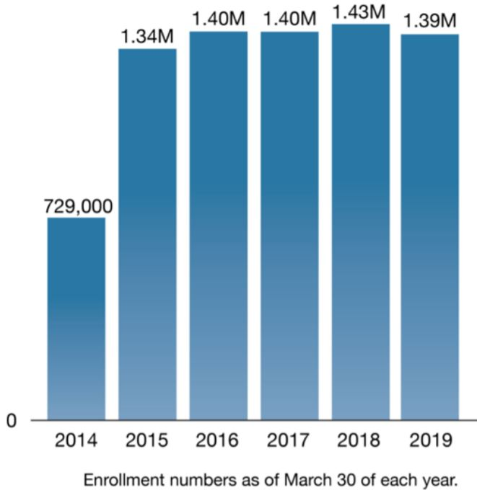
Federal policy changes led to a year of uncertainty
9
2019
Federal penalty zeroed out
  Health plans increased their premium on average 8%
  23.8% drop in new consumer enrollment
  Active renewals dipped by 2.5%
Consumers bombarded with offers of unqualified coverage

Slide 11
National Subsidized and Unsubsidized Individual Market Enrollment: 2014 - 2018
Source: CMS August 12, 2019 Trends in Subsidized and Unsubsidized Enrollment
IF nation had “only” dropped at California’s rate, 1.5 million more unsubsidized Americans would have insurance
National: Drop of 44% = 2.3 Million
California: Drop of 17% = 170,000
10

Slide 12
Ensuring access to a competitive marketplace in 2020
“
0.8% Statewide Average Increase
More than 75% of consumers will either be able to pay less or see no change in their premiums if they switch plans.
If consumers change to the lowest-priced plan at the same metal tier, the weighted average change would be a decrease of -9.0%
The overall story is a good one for consumers across California
Peter V Lee

Slide 13
5 Year Average Rate Change
Before shopping and not counting subsidy
 | PLAN YEAR |  |  |  |  | 5-Year Average
 | 2016 | 2017 | 2018 | 2019 | 2020
Weighted Average Increase | 4.0% | 13.2% | 12.5%* | 8.7% | 0.8% | 7.8%
Lowest-Priced Bronze (unweighted) | 3.3% | 3.9% | 11.8% | 10.2% | 5.7% | 7.0%
Lowest-Priced Silver (unweighted) | 1.5% | 8.1% | 9.2%* | 5.2% | 4.0% | 5.6%
If a consumer switches to the lowest-priced plan in the same tier | -4.5% | -1.2% | 3.3% | -0.7% | -9.0% | -2.4%
* The 2018 weighted average has been adjusted to remove the cost-sharing reduction surcharge applied in 2018, since unsubsidized or off-exchange enrollees do not incur the surcharge, and tax credits help defray the costs of rate increases for those eligible for subsidies.

Slide 14
Overview: Benefits for American Indians in Covered California

Slide 15
BENEFITS FOR AMERICAN INDIANS/ALASKAN NATIVE (AI/AN)
Many AI/ANs currently receive health care from Indian health care providers, which include health programs operated by the Indian Health Service (IHS), tribes and tribal organizations, and urban Indian organizations.
If AI/ANs enroll in a plan through Covered California, they can continue to receive services from their local Indian health care provider.
AI/ANs can enroll or switch plans in Covered California throughout the year, not just during the annual open enrollment period.
Depending on income, AI/ANs can enroll in a zero cost or limited cost sharing plan.

Slide 16
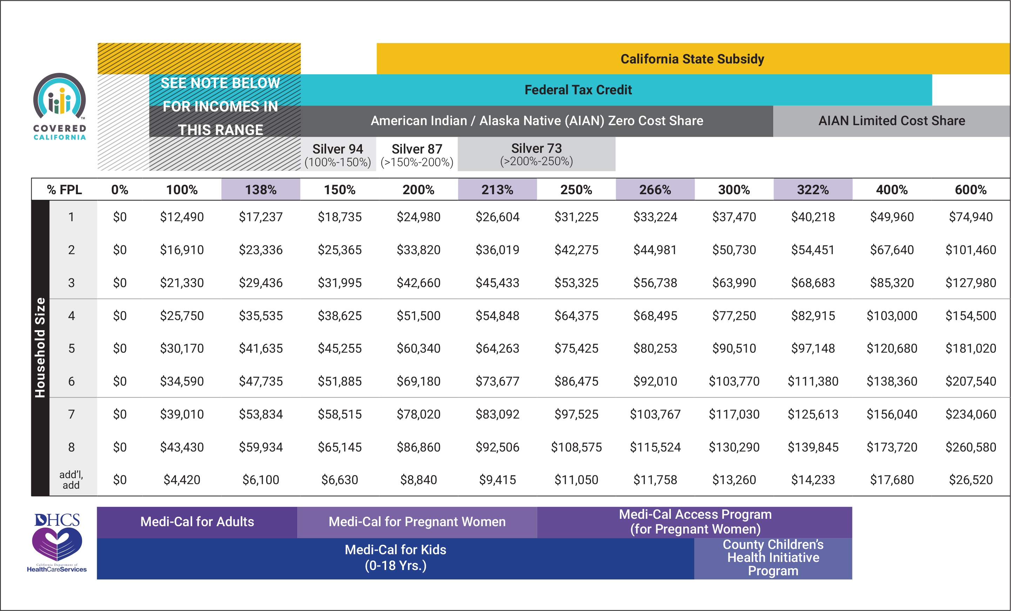
American Indian/Alaskan native Program eligibility
Program Eligibility by Federal Poverty Level-2020 Plan Year
Note overlapping programs by income level

Slide 17
AI/AN ELIGIBILITY: ZERO COST SHARE PLANS
AI/AN applicants are eligible for a zero cost sharing qualified health plan (QHP) if the applicants:
  Meet the eligibility requirements for APTC (Advance Premium Tax Credit) and CSR (Cost-Sharing Reduction)
  Are expected to have a household income that does not exceed 300 percent of the federal poverty level (FPL) for the benefit year for which coverage is requested
If the AI/AN applicant meets the above eligibility requirements for zero cost sharing plans, that applicant must be treated as an eligible insured and the QHP must eliminate any cost sharing
AI/AN consumers can only access these benefits if enrolled in a zero cost sharing plan through Covered California
Consumers can enroll in a non zero cost sharing plan, but will not receive the zero cost sharing benefit

Slide 18
AI/AN ELIGIBILITY: LIMITED COST SHARE PLANS
AI/AN applicants are eligible for limited cost sharing plans when their household income exceeds 300 percent of the FPL for the benefit year for which coverage is requested
If the AI/AN applicant meets the above eligibility requirements for limited cost-sharing plan, the QHP must:
  Eliminate any cost-sharing under the plan for the services or supplies received directly from an Indian Health Service, an Indian Tribe, Tribal Organization, or Urban Indian Organization
  Apply standard cost-sharing for the QHP’s provider network outside of Indian and Tribal providers
AI/AN consumers can only access these benefits if enrolled in a limited cost sharing plan through Covered California
Consumers can enroll in a non limited cost-sharing QHP, but will not receive the reduced cost-sharing benefit

Slide 19
AMERICAN INDINA/ALASKA NATIVE BENEFIT EXAMPLE
The following is an example of the differences in cost sharing between a Silver 70 standard plan, a Zero Cost Share AI/AN plan and a Limited Cost Share AI/AN plan for some covered services.
 | Silver 70 Standard Plan | Zero Cost Share AI/AN Plan | Silver 70 Limited Cost Share AI/AN Plan | Silver 70 Limited Cost Share AI/AN Plan if Member Goes to an AI/AN Provider*
Primary Care Visit | $40 | $0 | $40 | $0
Specialist Visit | $80 | $0 | $80 | $0
Laboratory Tests | $40 | $0 | $40 | $0
Urgent Care Visit | $40 | $0 | $40 | $0
*Indian Health Service (IHS), an Indian tribe, Tribal Organization, Urban Indian Organization, or receives a referral to a QHP provider from an IHS clinic.

Slide 20
AMERICAN INDIAN/ALASKA NATIVE QUALIFIED HEALTH PLAN (QHP) REQUIREMENTS
Covered California requires QHP issuers to offer the lowest cost AI/AN Zero Cost Share plan variation in the standard set of plans for each product (HMO, PPO, EPO).
The QHP issuer may not offer the Zero Cost Share AI/AN plan variation at the higher metal levels within the set of plans for each product .
  For example, if a QHP offers a PPO product for Platinum, Gold, Silver and Bronze metal tiers, the QHP must offer a Bronze AI/AN Zero cost share plan because it’s the lowest cost premium.

Slide 21
AMERICAN INDIAN/ALASKA NATIVE QUALIFIED HEALTH PLAN (QHP) ISSUER REQUIREMENTS
QHP issuers offering additional plans, that do not include a Bronze plan, must offer the AI/AN Zero Cost Share plan variation at the lowest cost.
If a QHP issuer offers a HMO product for Platinum, Gold and Silver metal tiers, the QHP issuer must offer a Silver AI/AN Zero Cost Share plan because it’s the lowest cost premium.
QHP issuers are required to offer Limited Cost Share plans at all metal levels for all product types.

Slide 22
COVERAGE FOR OUT-OF-NETWORK SERVICES
The requirement for a QHP issuer to offer Zero Cost Share or Limited Cost Share benefits applies to “covered services” under the plan.
QHP issuers are not required to offer Zero Cost Share or Limited Cost Share benefits for services received by out-of-network providers.
American Indian/ Alaska Native enrollees would be responsible for 100% of the cost of services received from out-of-network providers when enrolled in a plan with a closed provider network.
Closed provider networks include:
  Health Maintenance Organizations (HMO)
  Exclusive Provider Organizations (EPO)
Notes:
If an AI/AN enrollee was enrolled in a PPO plan with out of network coverage,
$0 cost share – OON cost sharing is $0
Limited cost share – OON cost sharing will be the same as the standard PPO plan for that metal tier

Slide 23
AI/AN Enrollment In Covered California

Slide 24
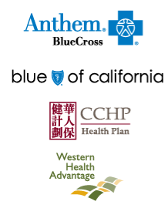
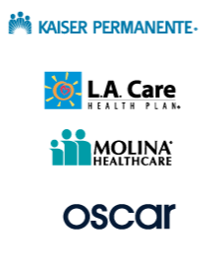



AMERICAN INDIAN/ALASKA NATIVE ENROLLMENT PER ISSUER
2019 AI/AN Enrollment (Active or Pending Status) as of 07/01/19
Issuer | # of Individuals
Anthem Blue Cross | 555
Blue Shield | 1,801
Chinese Community Health Plan | 5
Health Net | 296
Kaiser | 1,826
LA Care | 44
Molina Health Care | 99
Oscar Health Plan | 102
SHARP Health Plan | 46
Valley Health | 11
Western Health | 44
Grand Total | 4,829

Slide 25
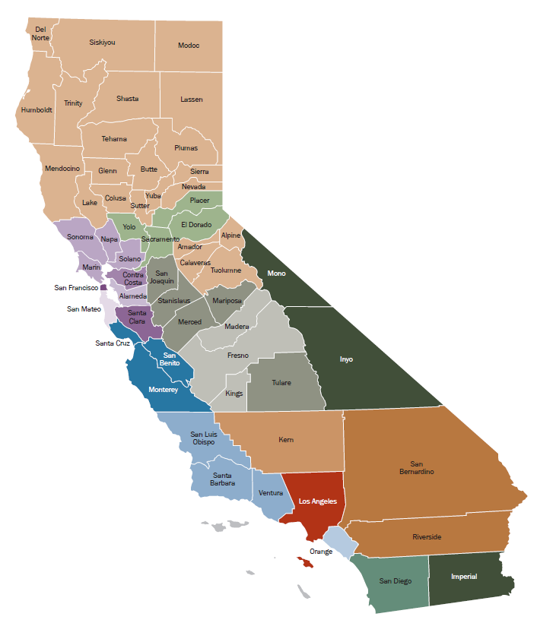
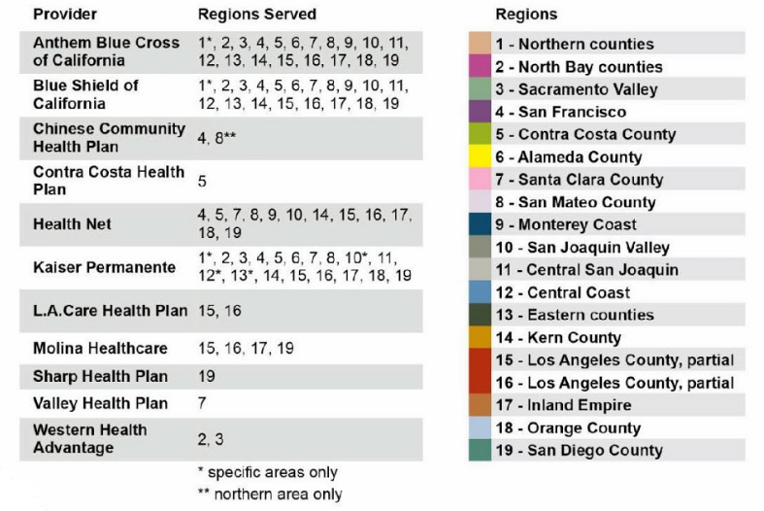
AMERICAN INDIAN/ALASKA NATIVE ENROLLMENT PER ISSUER REGION
2019 AI/AN Enrollment (Active or Pending Status) as of 07/01/2019
Pricing Region | # of Individuals
Northern Counties | 814
North Bay | 304
Sacramento Valley | 530
San Francisco County | 88
Contra Costs County | 121
Alameda County | 155
Santa Clara County | 75
San Mateo County | 30
Monterey County | 101
San Joaquin County | 385
Central San Joaquin | 254
Central Coast | 225
Eastern Counties | 34
Kern County | 124
Los Angeles County, Partial | 220
Los Angeles County, Partial | 345
Inland Empire | 426
Orange County | 286
San Diego County | 312
Grand Total | 4,829
Notes:
Region 15-16 = Los Angeles County 565 total

Slide 26
CURRENT MIXED AMERICAN INDIAN/ALASKA NATIVE HOUSEHOLDS
Mixed Households
1,029
Issuer | # of Individuals
Anthem Blue Cross | 332
Blue Shield | 980
Chinese Community Health Plan | 0
Health Net | 160
Kaiser | 919
LA Care | 41
Molina Health Care | 60
Oscar Health Plan | 46
SHARP Health Plan | 31
Valley Health | 10
Western Health | 31
Grand Total | 2,610
*2019 Enrollment Active or Pending for Consumers indicating they are a member of AI/AN Tribe and are in a mixed AI/AN household (AI/AN and Non-AI/AN as of October 2019)

Slide 27
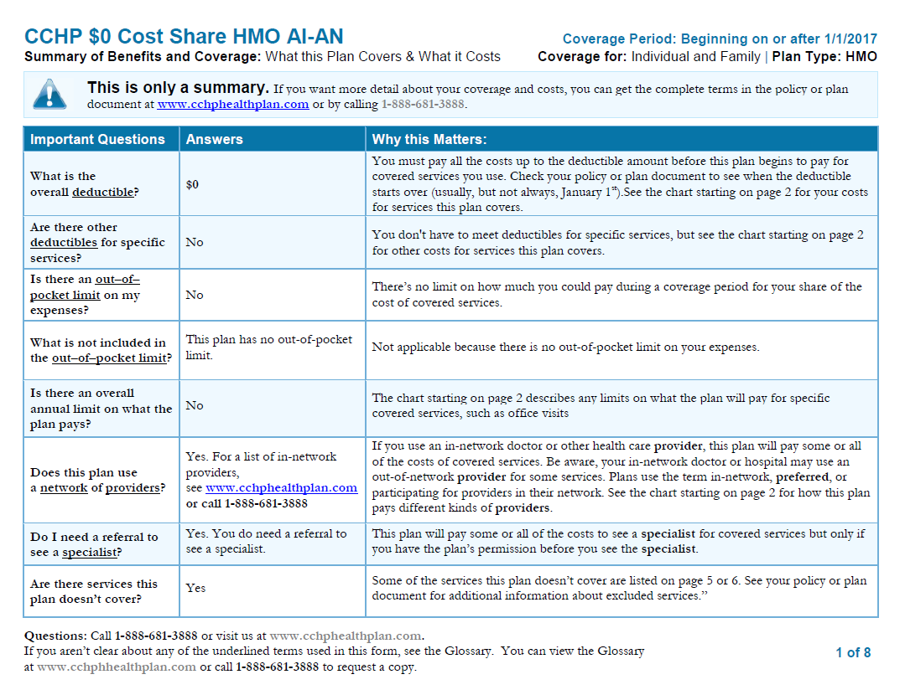
AMERICAN INDIAN/ALASKA NATIVE SPECIFIC EOCs AND SBCs
QHP issuers provide Evidence of Coverage (EOC) and Summary of Benefits and Coverage (SBC) for each metal tier by product type

Slide 28
COMPARISON PER ISSUER
Slight increases in enrollment from since 2017
September 2017
March 2018
February 2019
Issuer | # of Individuals
Anthem Blue Cross | 1,583
Blue Shield | 930
Chinese Community | < 10
Health Net | 126
Kaiser | 1,338
LA Care | 15
Molina Health Care | 165
Oscar Health Plan | 15
SHARP Health Plan | 84
Valley Health | 10
Western Health | 38
Grand Total | 4,310
Issuer | # of Individuals
Anthem Blue Cross | 673
Blue Shield | 1,717
Chinese Community | < 10
Health Net | 319
Kaiser | 1,785
LA Care | 48
Molina Health Care | 110
Oscar Health Plan | 81
SHARP Health Plan | 111
Valley Health | 18
Western Health | 45
Grand Total | 4,918
Issuer | # of Individuals
Anthem Blue Cross | 644
Blue Shield | 1,854
Chinese Community | < 10
Health Net | 330
Kaiser | 1,988
LA Care | 52
Molina Health Care | 114
Oscar Health Plan | 106
SHARP Health Plan | 71
Valley Health | 23
Western Health | 45
Grand Total | 5,238

Slide 29
COMPARISON PER REGION
September 2017
March 2018
February 2019
Pricing Region | # of Individuals
1 | 781
2 | 264
3 | 424
4 | 81
5 | 119
6 | 142
7 | 79
8 | 32
9 | 82
10 | 335
11 | 204
12 | 214
13 | 28
14 | 100
15 | 221
16 | 289
17 | 371
18 | 239
19 | 305
Grand Total | 4,310
Pricing Region | # of Individuals
1 | 829
2 | 285
3 | 514
4 | 89
5 | 131
6 | 188
7 | 92
8 | 40
9 | 97
10 | 369
11 | 230
12 | 236
13 | 30
14 | 125
15 | 241
16 | 377
17 | 396
18 | 288
19 | 358
Grand Total | 4,915
Pricing Region | # of Individuals
1 | 854
2 | 328
3 | 558
4 | 97
5 | 147
6 | 185
7 | 92
8 | 37
9 | 108
10 | 418
11 | 239
12 | 266
13 | 35
14 | 137
15 | 225
16 | 396
17 | 449
18 | 312
19 | 355
Grand Total | 5,238
Notes:
Region 15-16 = Los Angeles County 526 total

Slide 30
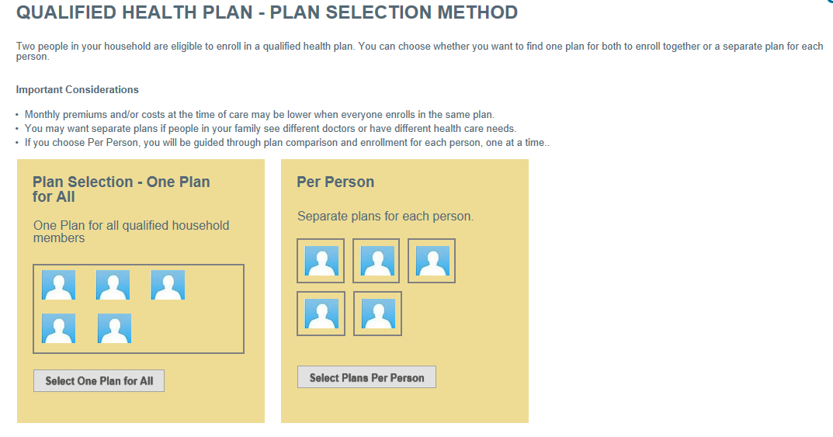
PLAN CHOICE FOR MIXED AI/AN HOUSEHOLDS

Slide 31
CERTIFIED ENROLLMENT ENTITIES (21)
Name of Entity | Program
American Indian Health and Services, Inc | CAC
California Rural Indian Health Board, Inc | CAC
Consolidated Tribal Health Project, Inc | CAC
Elk Valley Rancheria | CAC
Feather River Tribal Health, Inc | CAC
Fresno American Indian Health Project | CAC
Indian Health Center of Santa Clara Valley | CAC
Indian Health Council, Inc. | CAC
Karuk Tribe | CAC
Lake County Tribal Health Consortium, Inc. | CAC
Lassen Indian Health Center | CAC
MACT Health Board, INC. | CAC
Northern Valley Indian Health, Inc. | CAC
Pit River Health Service, Inc | CAC
Riverside San Bernardino Co Indian Health | CAC
San Diego American Indian Health Center | CAC
Santa Ynez Tribal Health Clinic | CAC
Shingle Springs Tribal Health Program | CAC
Southern Indian Health Council, Inc. | CAC
Toiyabe Indian Health Project | CAC
Tule River Indian Health Center, Inc. | CAC
*Updated October 2019

Slide 32
California State Affordability Initiatives

Slide 33
State and federal updates
California Affordability Programs
  In late June, the Governor signed the state’s fiscal year 2019-20 budget which:
    Establishes a state subsidy program providing premium subsidies over the next three years for eligible individuals with incomes at or below 138 percent of the Federal Poverty Level (FPL) and above 200 and at or below 600 percent of the FPL.
    Establishes a California individual mandate and penalty starting in 2020 that closely mirrors the federal structure that was in place prior to the penalty being “zeroed out” by Congress.
    Expands state-only, full-scope Medi-Cal to individuals between 19 and 25 years old regardless of immigration status.

Slide 34
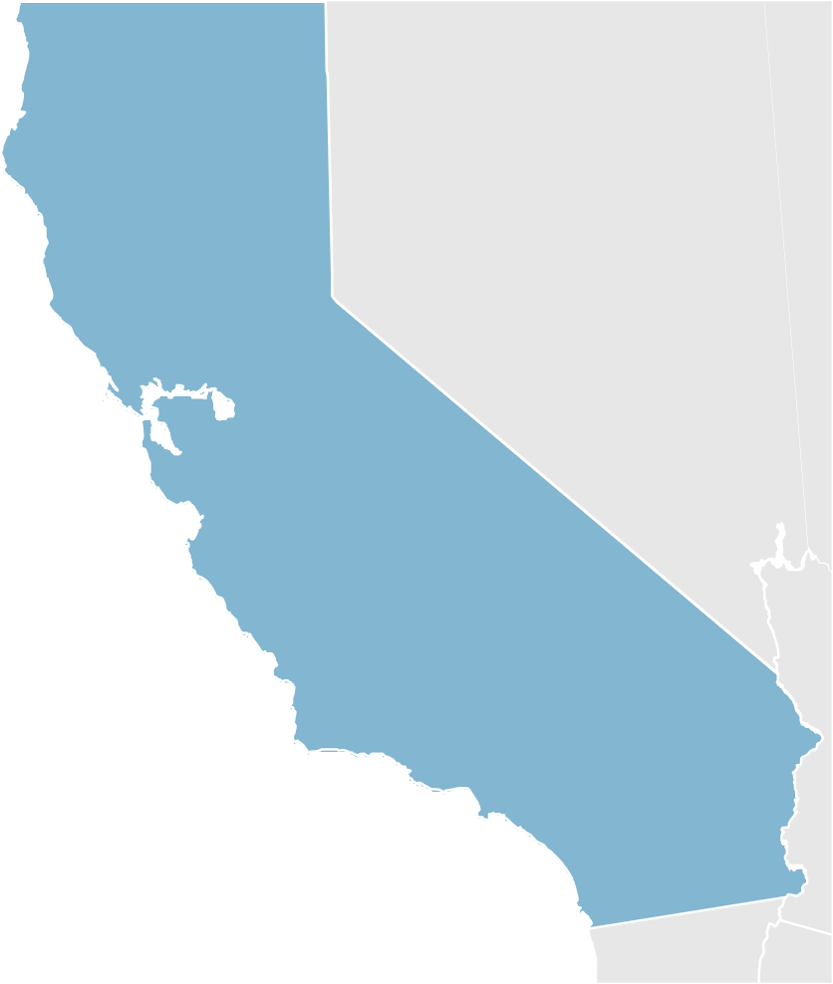


Improving affordability for Californians
California’s Health Care Affordability Programs
One and half billion dollars: 2020 - 2022
Only state affordability program in the country helping middle income individuals and families pay for health coverage
Consumers who earn up to 600% of Federal Poverty Level or incomes of $75,000 for individuals and $150,000 for families of four
State Individual Mandate and Penalty goes into effect January 1, 2020
Nearly a million Californians eligible

Slide 35
Improving affordability
California’s Health Care Affordability Programs
Effective January 1, 2020
State Subsidy
New financial help for individuals up to 138% and between 200-600% Federal Poverty Level (FPL)
Extends eligibility for financial help to nearly million Californians, including AI/AN consumers Covered California administers program
State Individual Mandate and Penalty
Requires Californians to enroll in minimum essential coverage, receive an exemption or pay a penalty.
Penalty is greater of $695 per adult ($347 per child) or 2.5% of annual household income
Franchise Tax Board implements and collects penalties AI/AN CONSUMERS ARE EXEMPT

Slide 36
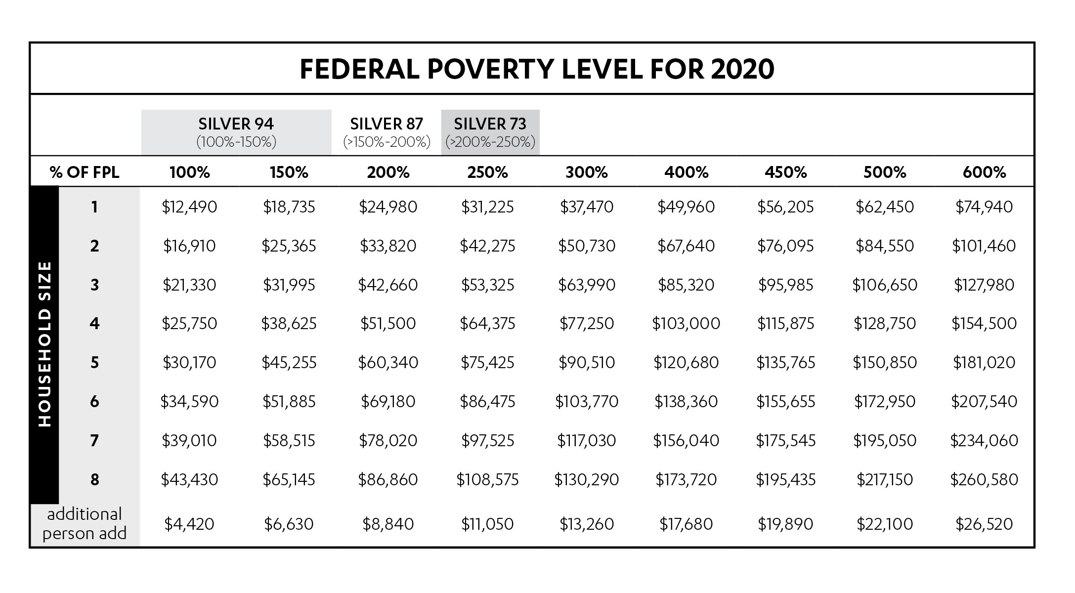
New 2020 FPL chart for the state subsidy program

Slide 37
What consumers pay before subsidy kicks in
0%-138%
200%-600% FPL

Slide 38
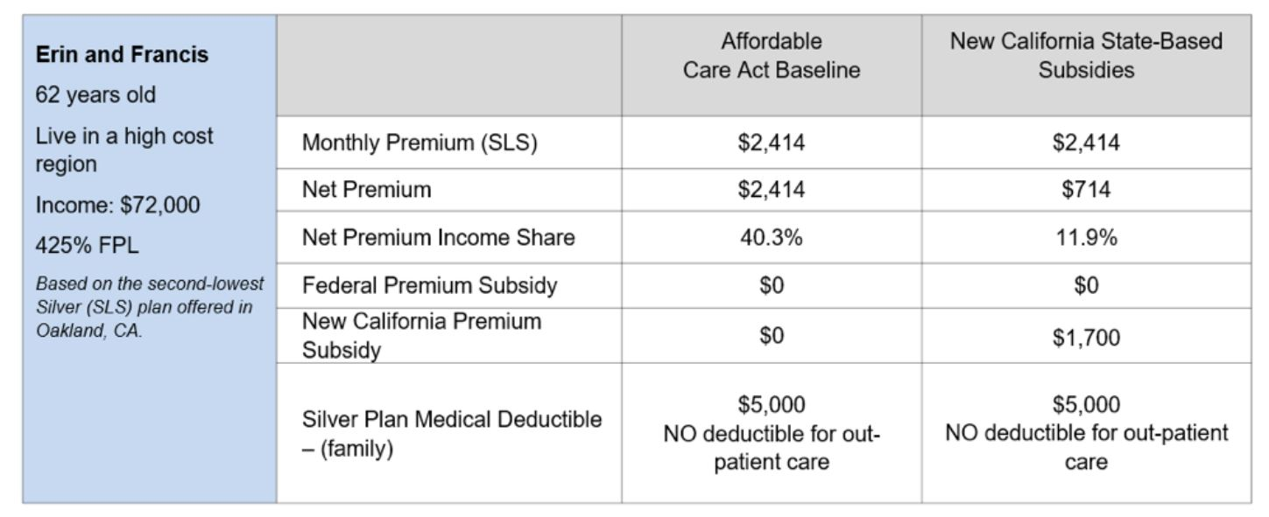
California subsidy scenario
Covered CA Message Evaluation | July 16, 2019

Slide 39
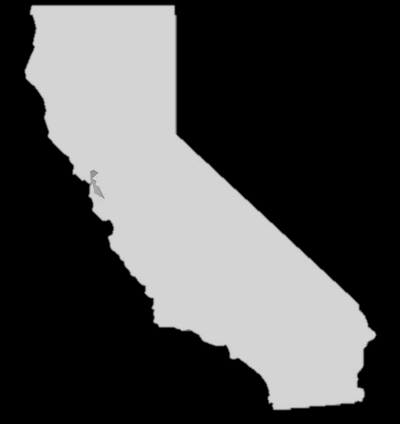
Understanding the cost of not having Minimal Essential Coverage
A minimum of $695 per adult ($347 per child)
Family members who are not AI/AN will be subject to the penalty even if the rest of the household is exempt.
OR
2.5% of the annual household income, whichever is greater
**For example, a family of five
could pay up to $16,980 in yearly
penalty

Slide 40
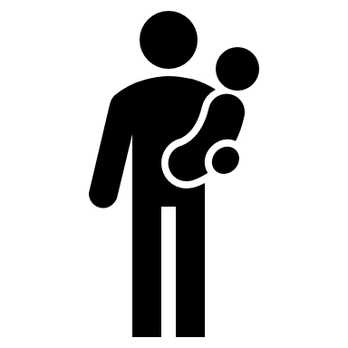



2020 Projections of Who Benefits—AI/AN Consumers Will Benefit Depending on Income
922,000
Individuals estimated eligible to receive a state subsidy
235,000
are middle-income Californians who don’t receive federal financial help
$172
per household per month average state subsidy for middle-income Californians earning 400-600% FPL
229,000
new enrollments projected due to lower premium, new subsidy and the mandate/penalty
42,000
projected new consumers enrolling off-exchange directly with carriers

Slide 41
Tribal Clinic Referrals
BACKGROUND AND UPDATE

Slide 42
BACKGROUND
At the last Tribal Consultation Meeting in 2018, Covered California agreed to further investigate possible gaps in the process by which American Indian/Alaska Native (AI/AN) enrollees are referred by Indian Health Clinics to Qualified Health Plan (QHP) providers for covered health care services.

Slide 43
IDENTIFIED CHALLENGES
More information and assistance with Indian Health Clinic referrals to QHP issuers is needed.
Indian Health Clinic referrals vary and QHP issuers need specified information to process referrals.
There is not a standard process flow for referrals between all QHP issuers.
Process is needed to obtain refund for any incorrect charges for health care services.

Slide 44
AMERICAN INDIAN/ALASKAN NATIVE ZERO-COST AND LIMITED-COST SHARING PLANS
Zero-cost sharing plans: If below 300 percent federal poverty level (FPL), consumer is eligible for AI/AN plan that is not subject to deductible, coinsurance and cost sharing. Does not need a referral from an Indian Health Clinic.
Limited-cost sharing plans: If above 300 percent FPL, consumer is not subject to deductible, coinsurance and cost sharing if receiving health care services from an Indian Health Clinic or with a referral to a QHP provider from an Indian Health Clinic.

Slide 45
WORK IN PROGRESS
Reaching out to several QHP issuers
  Gathering information on the current status of Indian Health Clinic referrals and their internal processes
  Shared draft Indian Health Clinic referral form template for review and feedback with carriers and Tribal partners
Creating model referral form

Slide 46
PROPOSED NEXT STEPS
Review, edit and finalize Indian Health Clinic suggested referral form template. The final document will be posted on the Covered California website with use instructions.
What other means should Covered California use to share materials and information with AI/AN consumers and providers?

Slide 47
Thank you!
Kelly Bradfield, Interim Tribal Liaison
Kelly.Bradfield@covered.ca.gov
(916) 228-8832

Slide 48
APPENDIX

Slide 49
2020 Tribal Advisory Workgroup
Northern | Southern | Central East | Central West | Non-Indigenous to CA | Non-Federally Recognized
Tribal Leadership Karen Shepherd, Sherwood Valley Band of Pomo Indians Tribal Health Programs Andrea Cazares-Diego, Greenville Rancheria Tribal Health Center Urban Indian Health Programs VACANT | Tribal Leadership Chris Devers, Pauma Band of Mission Indians Tribal Health Programs Della Freeman, Indian Health Council, Inc. Urban Indian Health Programs Scott Black, American Indian Health and Services | Tribal Leadership VACANT Tribal Health Programs Jess Montoya, Riverside-San Bernardino County Indian Health, Inc. Urban Indian Health Programs VACANT | Tribal Leadership Vickey Macias, Cloverdale Rancheria Tribal Health Programs Ronald Sisson, Santa Inez Tribal Health Clinic Urban Indian Health Programs VACANT | Member, Tribe Non-Indigenous to California PENDING | Member, Non-Federally Recognized Tribe Charlene Storr, Tolowa Nation

Slide 50
Closed Issues
Past
Topic | Issue | Status
Tribal Advisory Workgroup | 2016 Tribal Consultation feedback that the TAW should be revamped | Closed- New and existing TAW members appointed and met on 5/1/17
Application Issues- ability to include gaming income, tribe drop down list | Per-Capita gaming income unable to be counted, not all tribes were listed | Closed- gaming calculation corrected, list of Tribes and “other” option listed
Tribal Sponsorship | Recommendation that CC should invest in creating a system where Tribes can offer members payment for premiums. | Closed- No further action required by Tribal Advisory Workgroup
American Indian/Alaska Native Mixed Tribal Family Glitch | Mixed American Indian/ Alaska Native and Non-American Indian/ Alaska Native HH unable to enroll in one application on different plans | Closed- 16.7 changes implemented fix for member level benefits- See data next slide
American Indian/ Alaska Native Mixed Tribal Family Glitch- SEP Inquiry | During 2016 Tribal Consultation members expressed concerned dependents on application would not be able to change their plan during SEP. | Closed- Per new federal guidelines, Covered California American Indian/ Alaska Native application allows all household dependents to make changes
Enrollment in non-lowest cost American Indian/ Alaska Native plan | American Indian/ Alaska Native members enrolled in a plan that is the same coverage as the lowest cost American Indian/ Alaska Native plan but paying a higher premium by enrolling in a Platinum/Gold/Silver plan. These plans need to decertified. | Closed- non-lowest cost AI/AN plans in Covered California have been deactivated.

Slide 51
Current Issues
Present
Topic | Issue | Status
Indian Health Program Referral | Education information needed between QHP and Tribal clinics on referrals | Ongoing
Website and Outreach Materials | Updates needed to factsheet and website. | Ongoing- Need feedback from Tribes and Tribal organizations
Tribal Advisory Workgroup Structure | Today’s workgroup needs more flexibility in order to increase meaningful engagement | Ongoing (more information pending January meeting)

